Slide 1
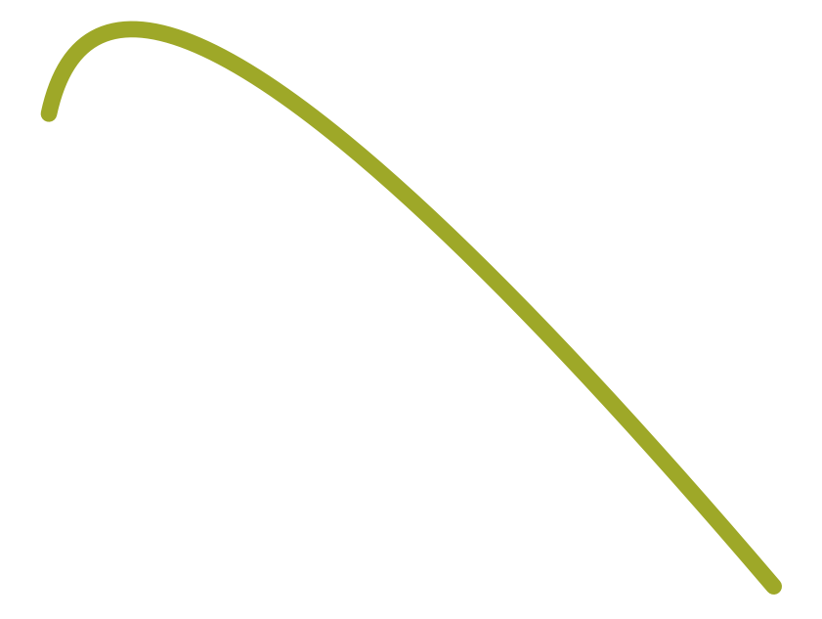

Traditional RNN Seq2Seq model
7
(Challenges)
Decoder (RNN)
o₁
o₂
o₃
[1] Bottleneck
The meaning of the entire input sequence is
Expected to be captured by a single context vector
with fixed dimensionality
softmax
softmax
softmax
s₁
s₂
s₃
h₁
h₂
embedding x₁
embedding x₂
embedding x₃
Context Vector (of Whole Inputs)
x₁
x₂
x₃
Encoder (RNN)

