Slide 1
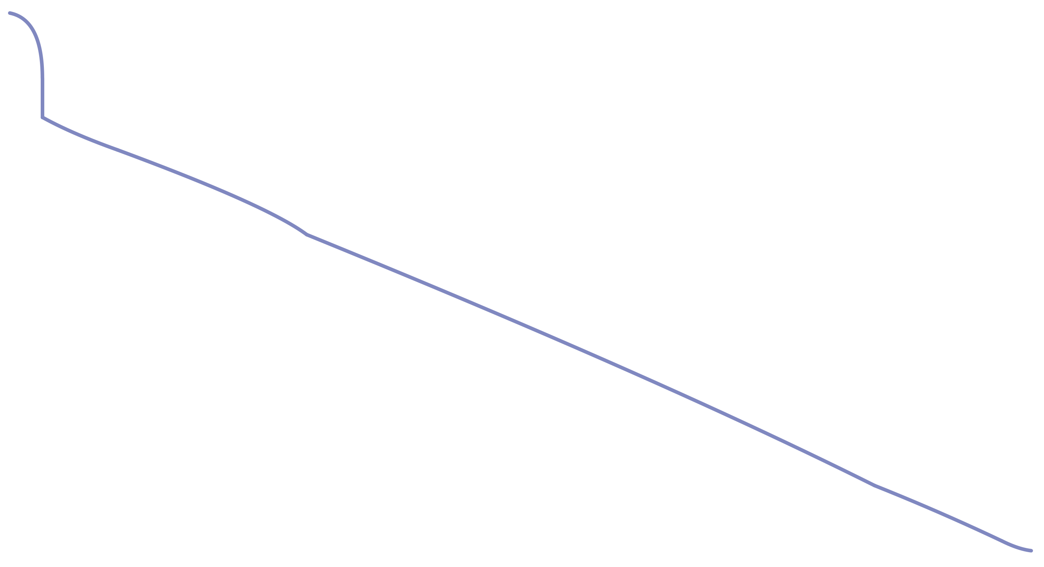
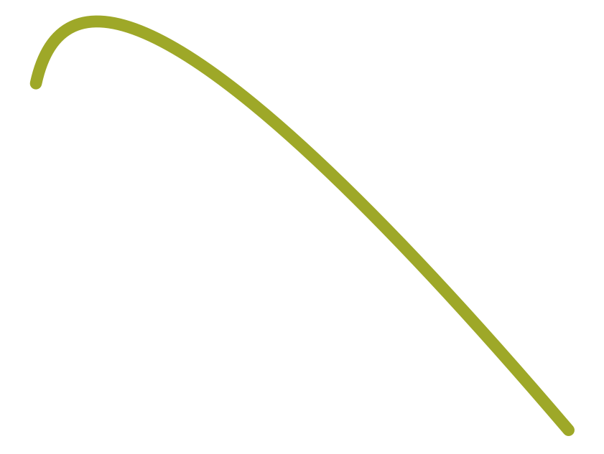

Traditional RNN Seq2Seq model
9
(Challenges)
Decoder (RNN)
[3] Very Long Sequence
Vanishing Gradient
o₁
o₂
o₃
softmax
softmax
softmax
Short Sequence: RNN
Long Sequence: LSTM, GRU
Very Long Sequence: FAIL
s₁
s₂
s₃
h₁
h₂
Back Propagation
embedding x₁
embedding x₂
embedding x₃
x₁
x₂
x₃
x₀
x₁
x₂
x₃
x₄
x₅
x₆
x₇
x₈
x₉
x₁₀
Encoder (RNN)

