Slide 1
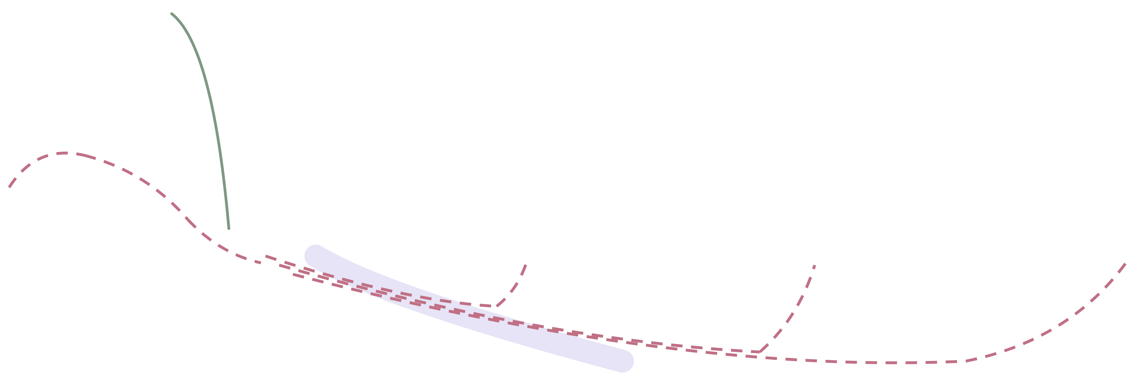


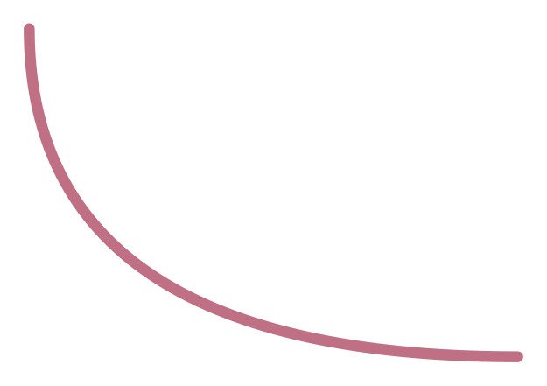
RNN Seq2Seq model [with Attention]
10
[ To overcome Bottleneck challenge]
Decoder
o₁
o₂
o₃
weighted sum of the hidden states
softmax
softmax
softmax
Attention
attention
s₁
s₂
s₃
h₁
h₂
Attention
embedding x₁
embedding x₂
embedding x₃
Context Vector (of Whole Inputs)
Decoder Utilizes:
Context Vector
x₁
x₂
x₃
Weighted sum of hidden states
Encoder

