Slide 1


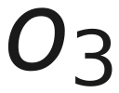
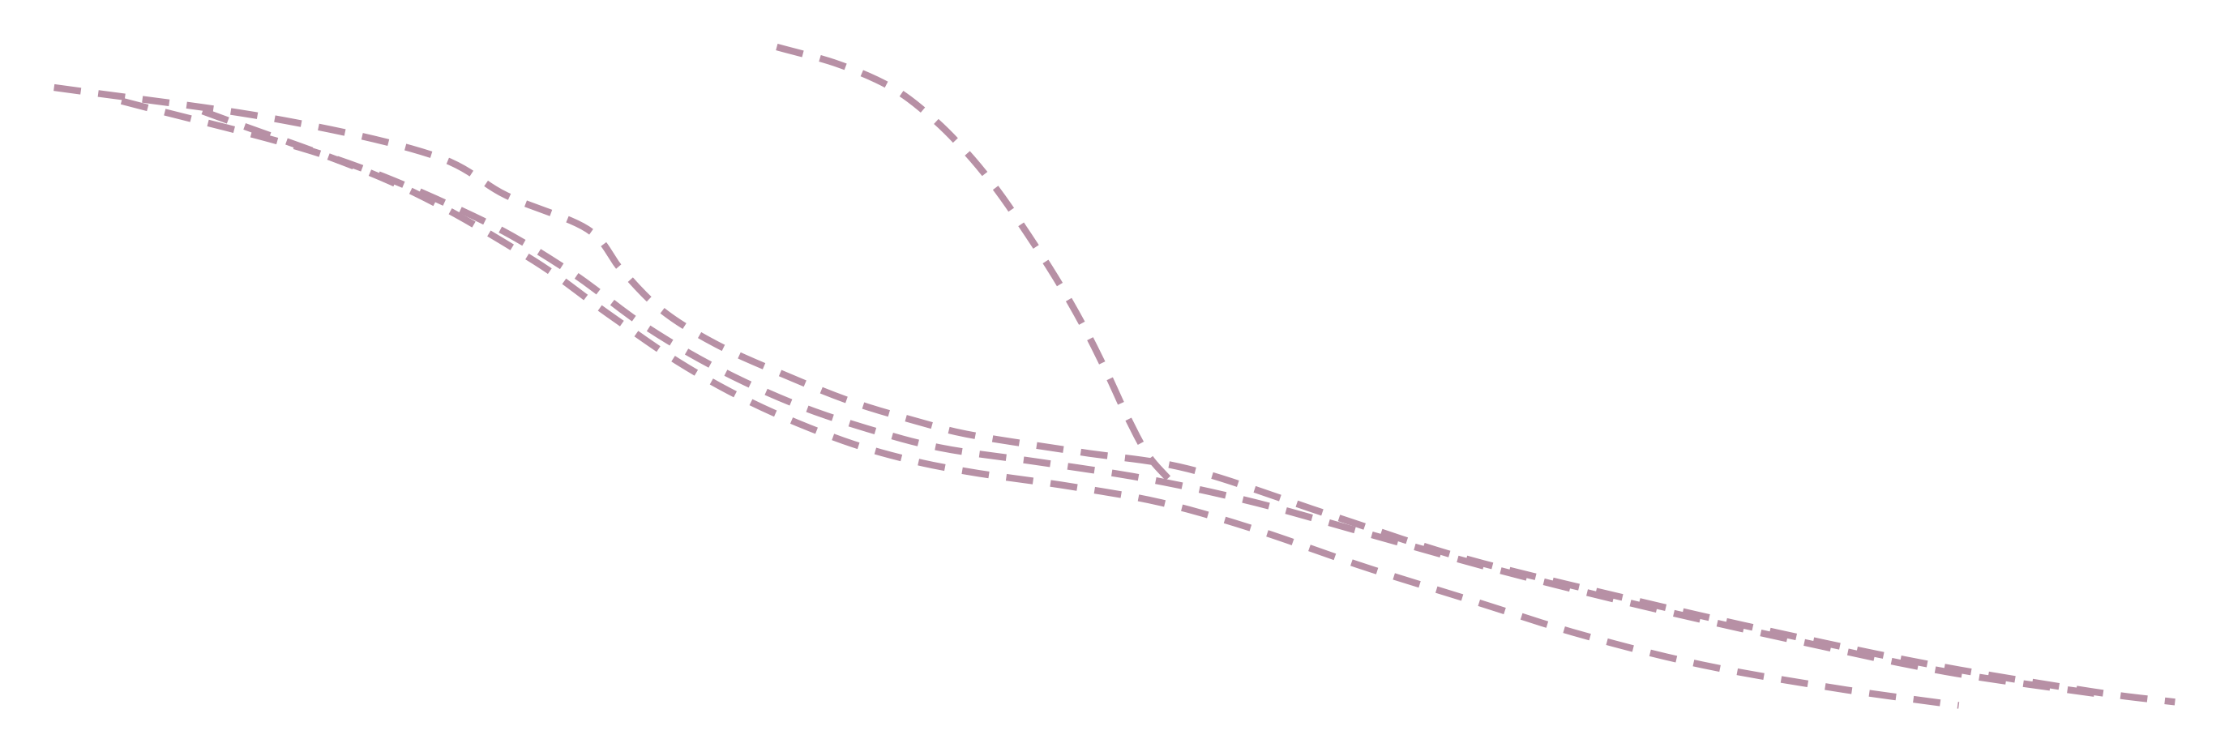





Transformer
11
Attention is All You Need
Decoder
Encoder-Decoder Attention
Multi Head Self Attention Blocks
attention
Encoder-Decoder Attention
Multi Head Self Attention Blocks
Attention Mechanism supports:
• Parallelization of Encoder ,
• Parallelization of Decoder ( Training Mode Only)
Encoder
• Very Long Sequence length

