Slide 1

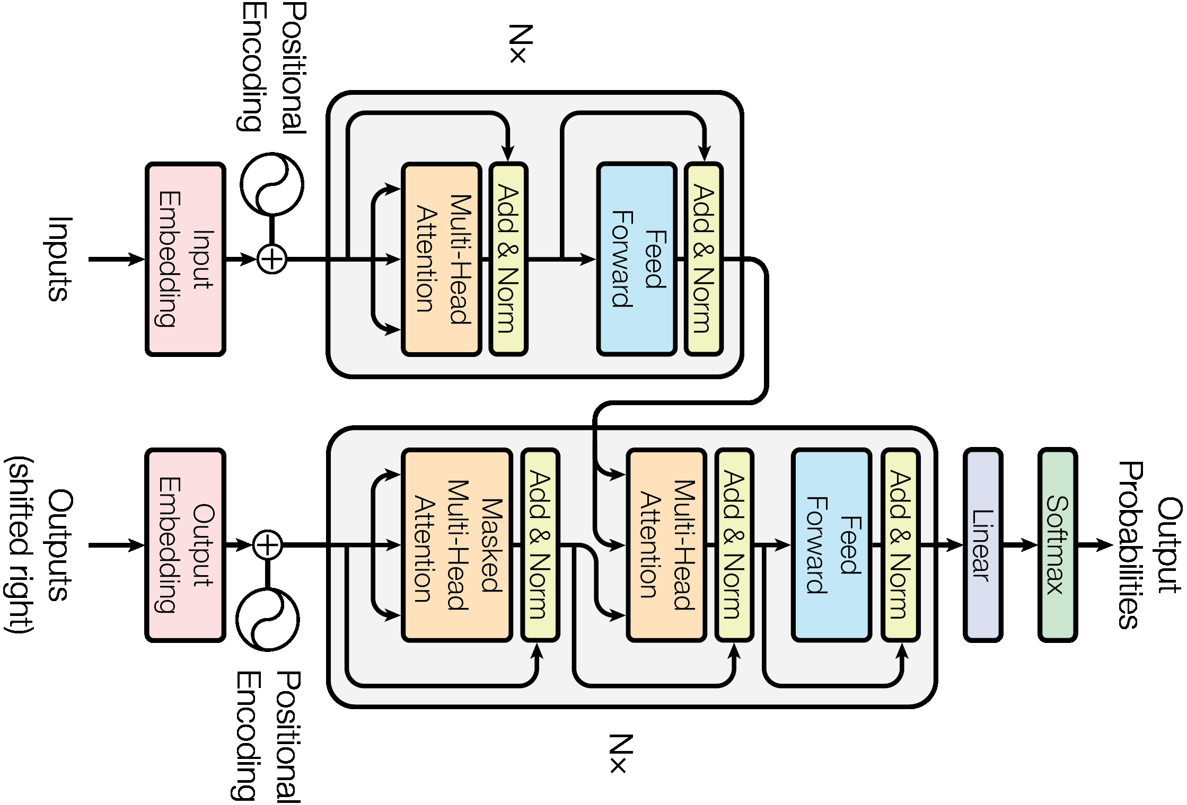

Encoder – Decoder Transformer
14
Orientation is not the Issue
Let us focus on the Building blocks

