Slide 1
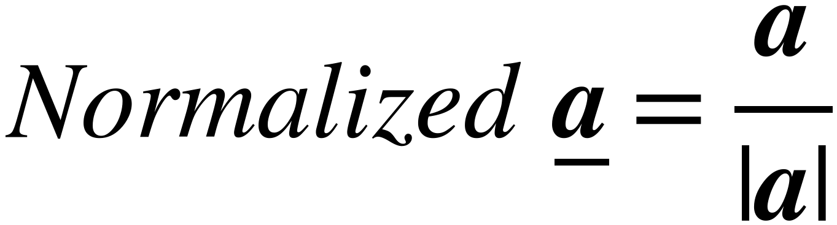
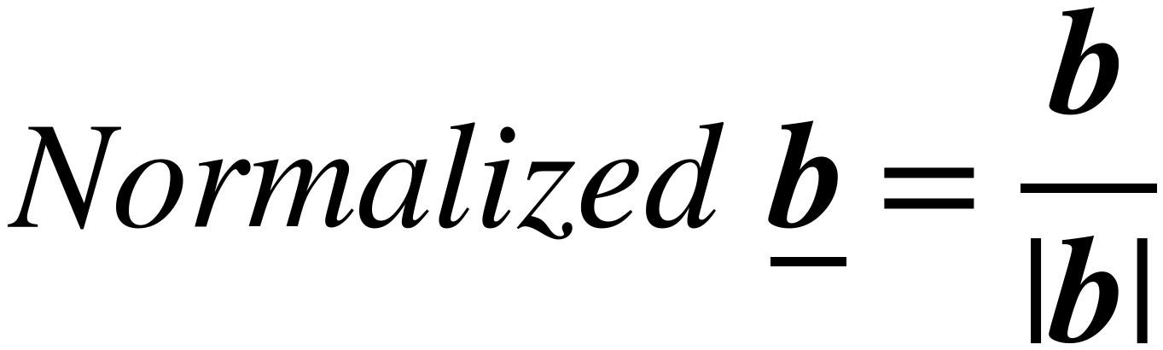

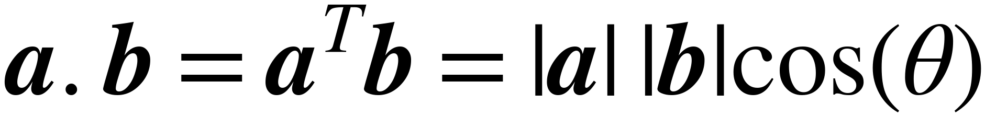
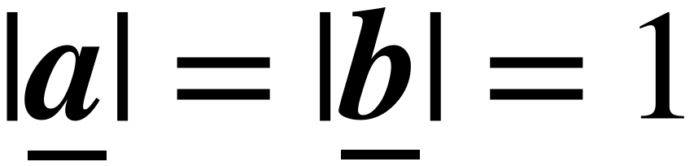
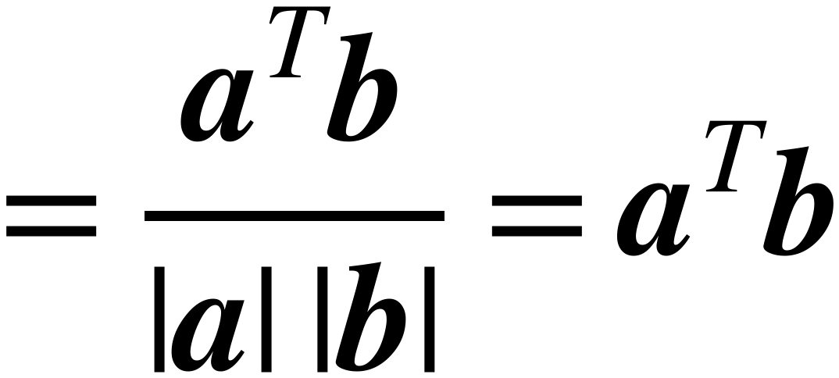

Review: Cosine Similarity
23
Vectors must be normalized
before calculate similarity
Their Lengths = 1
b
b
a
a
Normalize
After Normalization
Cosine Similarity is between -1 , +1
It is a dot product between two Normalized vectors a and b
Maximize [Similarity] = Minimize -[Similarity]
Loss = -[Similarity]

