Slide 1
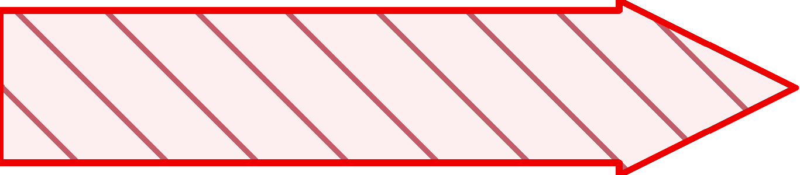
Objective of Self attention
24
in
The boy climbs the tree in the garden
garden
the
Boy
Boy
tree
climbs
Boy

