Slide 1
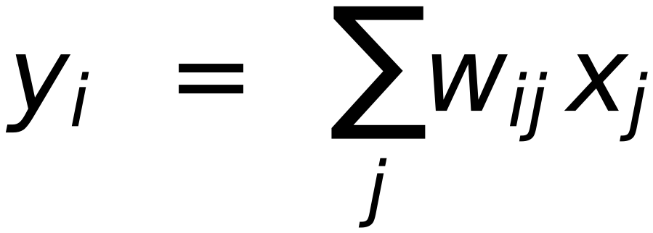
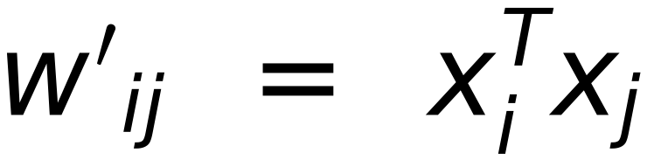
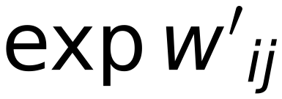
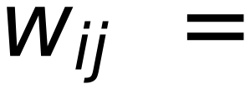
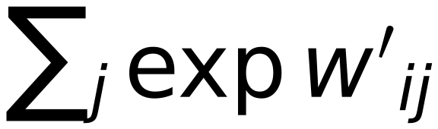
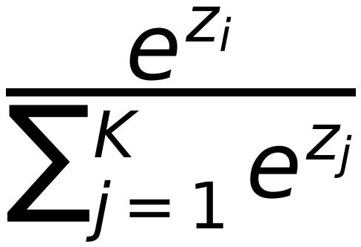
Self Attention Mechanism (Fundamental Operation)
27
(Self Attention of word X₂ w.r.t All words in Sentence ( X₁, X₂, X₃, X₄ )
Y
Similarity
Probabilities
Weighted SUM
X_{ℓ}
Dot
Product
Σ
W₂₁
X₁
X₁
W₂₂
X₂
Soft max
X₂
W₂₃
X₃
X₃
W₂₄
X₄
X₄
Output
layer
Softmax
activation function
Probabilities
X_{i} = X₂
1.3
5.1
2.2
0.7
1.1
0.02
0.90
0.05
0.01
0.02
X₁
X₂
X₃
X₄
Remember

