Slide 1
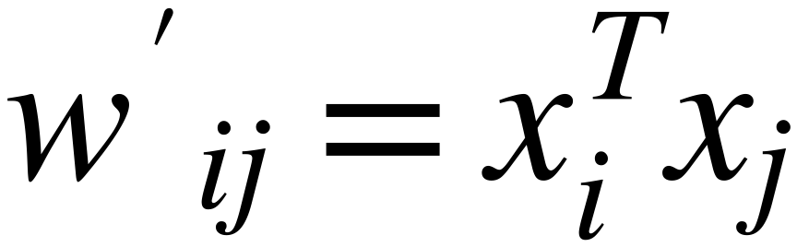




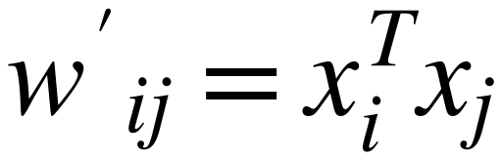



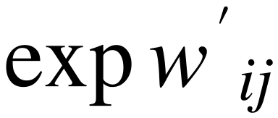
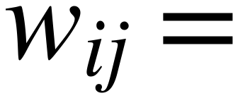
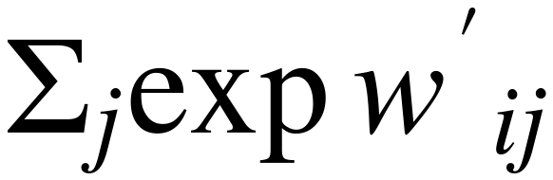
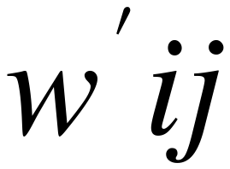
Self Attention Mechanism
34
(Embedding Vector Dimension and Softmax Sensitivity)
1×d
d
As Dimension of Embedding "d" Increases
the Calculated weight value "w" increases
High Weight Values kill the gradient, and slow down learning
SoftMax
1×d
d
d
d
1
0.0321
5
0.0000
10
0.0000
2
SoftMax
0.0871
10
SoftMax
0.0000
20
SoftMax
0.0000
3
0.2369
15
0.0067
30
0.0000
4
0.6439
20
0.9933
40
1.0000
For small "d"
For medium "d"
For large "d"

