Slide 1
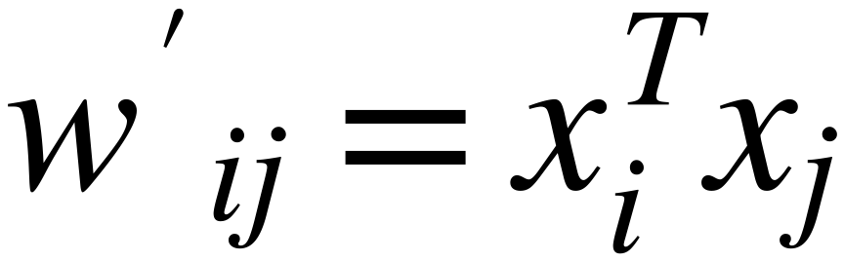




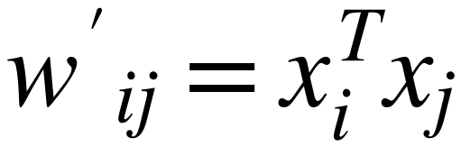



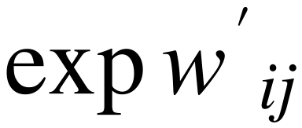
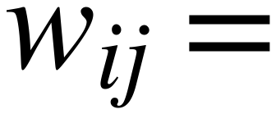
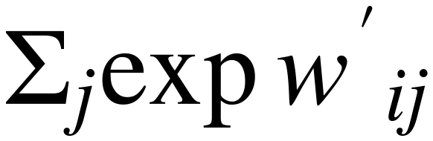
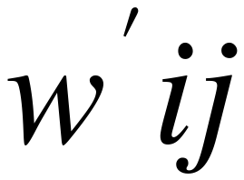
Self Attention Mechanism
35
(Embedding Vector Dimension and Softmax Sensitivity)
Scale down "Weights" Values
1×d
before applying SoftMax
d
Scaling Factor should be related to
As Dimension of Embedding "d" Increases
Embedding Dimension "d"
the Calculated weight value "w" increases
High Weight Values kill the gradient, and slow down learning
SoftMax
1×d
d
d
d
1
0.0321
5
0.0000
10
0.0000
2
SoftMax
0.0871
10
SoftMax
0.0000
20
SoftMax
0.0000
3
0.2369
15
0.0067
30
0.0000
4
0.6439
20
0.9933
40
1.0000
For small "d"
For medium "d"
For large "d"

