Slide 1
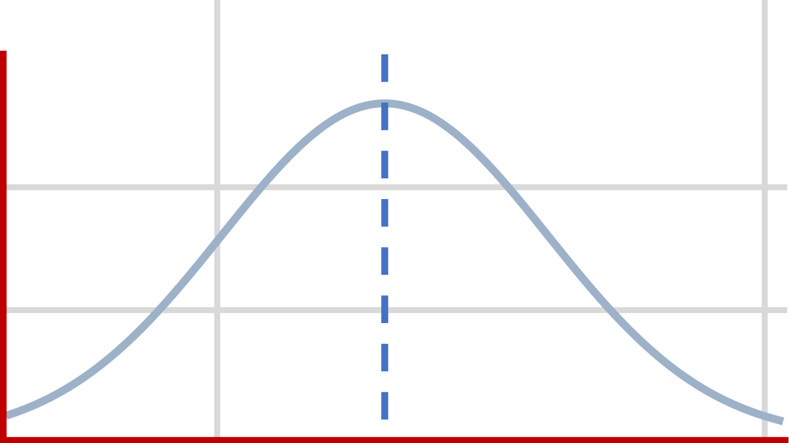


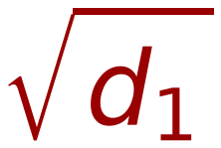
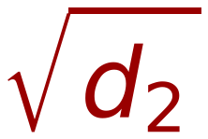
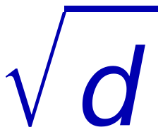
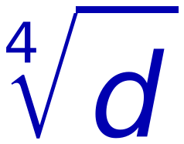


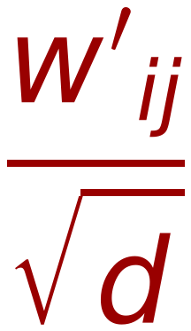

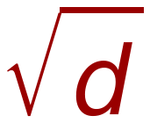
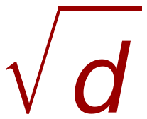
36
Self Attention Mechanism
(Scaling based on Square Root of Embedding Vector Dimension)
V₁
V₂
V₁
V₂
Let Average Values of elements of V₁ = M
X₁
X₁
M
M
Let Average Values of elements of V₂ = M
X₂
X₂
M
M
Vector Length of V₁ (all Ms) = V₁^{T} V₁ = M
X₃
X₃
M
M
X₄
X₄
M
M
Vector Length of V₂ (all Ms) = V₂^{T} V₂ = M
X₅
1xd₂
M
1xd₂
M
X₆
M
X₇
M
is a good choice for scaling
Some times is used
X₈
M
X₉
M
X₁₀
M
X₁₁
M
X₁₂
M
SoftMax
SoftMax
d=100,
=10
1xd₁
1xd₁
Remember:
10
0.0000
10
1
0.0321
"d" is
Dimension of Embedding
20
SoftMax
0.0000
20
/
Scaled
2
SoftMax
0.0871
Not
30
0.0000
30
3
0.2369
length of input Sequence
40
1.0000
40
4
0.6439

