Slide 1




















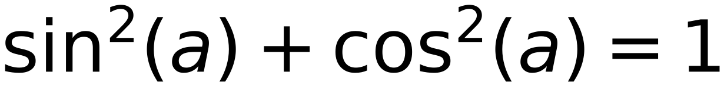















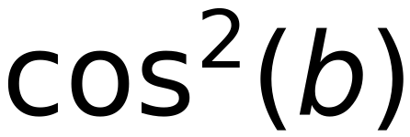
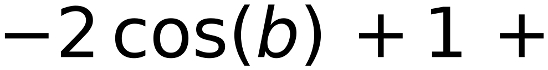
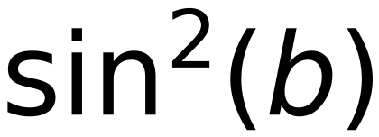

Vector at Pos “t”
Vector at Pos “t+δ”
31
Squared Distance Between
Vector of Pos “t+δ”
and
Vector of Pos “t”
[ Two Consecutive Positions ]
Irrespective of Position “t”

