Slide 1

1
Deep Learning
DSAI 308
+
Prepared By
Dr. Khaled Mostafa ElSayed
kmelsayed@zewailcity.edu.eg
Instructors:
Dr. Khaled Mostafa ElSayed
kmelsayed@zewailcity.edu.eg
Dr. Mohamed Maher Ata
momaher@zewailcity.edu.eg

Slide 2
2
Transformers
Part II
Aug. 2020

Slide 3
3
Review of
Part I
Self Attention Mechanism

Slide 4





Encoder – Decoder Transformer
4
Encoder
Decoder

Slide 5
Encoder – Decoder Transformer
5
Both Encoder and Decoder Blocks Contain
“Multi-Head Self Attention” block
Encoder
Output
Decoder
Probabilities
“h” Heads
Outputs of Heads are concatenated
Softmax
Linear
Multi-Head Attention
Add & Norm
Scaled Dot-Product
Attention
Feed
Forward
Add & Norm
Linear
Add & Norm
Multi-Head
Attention
Multi-Head
Attention
MatMul
Feed
Forward
V
N x
Concat
K
Q
SoftMax
N x
Add & Norm
Add & Norm
Multi-Head
Attention
Masked
Multi-Head
Attention
Mask (opt.)
Scaled Dot-Product
Attention
Multi-Head
Attention
h
V
V
K
Q
Scale
Linear
Linear
Linear
K
Q
Positional
Encoding
Positional
Encoding
MatMul
Input
Embedding
Output
Embedding
Q
K
V
V
K
Q
Inputs
Outputs
(shifted right)

Slide 6
Transformers – Part II
6
Parallelization Implementation Issues
Positional Information
Building Transformer Block
Transformer Decoder
Transformer Encoder as a Classifier
What is Next ?

Slide 7
7
Parallelization
Implementation Issues

Slide 8
Self Attention Mechanism (Linear Transformation of Inputs)
8
(Self Attention of word X₂ w.r.t All words in Sentence ( X₁, X₂, X₃, X₄ )
Y
Similarity
Probabilities
Weighted SUM
Dot
Product
K.q
Σ
X₄
W_{k}^{(r)}
K₄
*
V₄
W_{v}^{(r)}
X₄
X₃
W_{k}^{(r)}
K₃
V₃
W_{v}^{(r)}
X₃
Soft max
*
X₂
W_{k}^{(r)}
K₂
*
V₂
W_{v}^{(r)}
X₂
X₁
W_{k}^{(r)}
K₁
*
V₁
W_{v}^{(r)}
X₁
q₂
W_{q}^{(r)}
W
X₁
X₂
X₃
X₄
W
=
1*d
d*d
1*d
d: Embedding Length

Slide 9
9
Using FF NN for Multiplication of a Vector by a Matrix
Input Word X
[
X₁
X₂
X₃
X₄
]
y₁
W₁₁
W₂₁
W₃₁
W₄₁
b₁
X₁
W₁₁
Σ
Y^{T}
X
W₂₁
[
]
W₁₂
W₂₂
W₃₂
W₄₂
b₂
b₁
y₁
y₂
y₃
y₄
= Sigmoid
+
W₃₁
W₁₃
W₂₃
W₃₃
W₄₃
b₃
W₄₁
W₁₂
y₂
W₁₄
W₂₄
W₃₄
W₄₄
b₄
X₂
W₂₂
Σ
W₃₂
b₂
W₄₂
W₁₃
W₂₃
y₃
X₃
W₃₃
Σ
W₄₃
b₃
W₁₄
W₂₄
W₃₄
y₄
X₄
W₄₄
Σ
b₄

Slide 10
Using FF NN for Multiplication of ONE Vector by a Matrix
10
Example: Multiply Vector of Current Word X by W_{q} (Query) {Remember: W_{q} is Squared Matrix}
Input Word X
[
x₁
x₂
x₃
x₄
]
y₁
W₁₁
W₂₁
W₃₁
W₄₁
b₁
X₁
W₁₁
Σ
Y
T
X
[
]
W₁₂
W₂₂
W₃₂
W₄₂
b₂
W₂₁
=Sigmoid
+
y₁
y₂
y₃
y₄
W₁₃
W₂₃
W₃₃
W₄₃
W₃₁
b₃
W₄₁
W₁₂
y₂
W₁₄
W₂₄
W₃₄
W₄₄
b₄
X₂
W₂₂
Σ
W₃₂
IF No
Non-linearity
W₄₂
IF No Bias
W₁₃
[
x₁
x₂
x₃
x₄
]
W₂₃
y₃
W₁₁
W₂₁
W₃₁
W₄₁
0
X₃
W₃₃
Σ
Y
T
X
W₄₃
[
]
W₁₂
W₂₂
W₃₂
W₄₂
0
W₁₄
y₁
y₂
y₃
y₄
=Linear
+
W₁₃
W₂₃
W₃₃
W₄₃
0
W₂₄
W₃₄
y₄
W₁₄
W₂₄
W₃₄
W₄₄
X₄
W₄₄
Σ
0

Slide 11






11
Y
Y
Similarity
Y
Weighted SUM
h=5
Similarity
Weighted SUM
h=4
Similarity
Weighted SUM
h=3
X₁
Similarity
Probabilities
Weighted SUM
h=2
Similarity
Probabilities
Weighted SUM
h=1
X₁
X₂
Dot
Product
K·q
$$K⋅q$$
Σ
X₁
X₁
X₂
X₃
W_{v}⁽⁰⁾
K₁
$$\sqrt{d}$$
X₁
×
V₁
W_{v}⁽⁰⁾
X₁
X₂
X₃
X₄
X₂
X₂
W_{v}⁽⁰⁾
K₂
V₂
W_{v}⁽⁰⁾
X₂
X₃
"H" Heads
×
X₃
X₄
X₃
W_{v}⁽⁰⁾
K₃
V₃
W_{v}⁽⁰⁾
X₃
X₄
W_{q}⁽⁵⁾
×
X₄
X₄
W_{v}⁽⁰⁾
K₄
V₄
W_{v}⁽⁰⁾
X₄
W_{q}⁽⁴⁾
W_{k}⁽⁵⁾
×
W_{q}⁽³⁾
W_{k}⁽⁴⁾
W_{v}⁽⁵⁾
q₁
W_{q}⁽²⁾
W_{k}⁽³⁾
W_{q}⁽⁰⁾
W_{q}⁽¹⁾
W_{k}⁽²⁾
W_{v}⁽⁴⁾
W_{v}⁽³⁾
X₂
W_{k}⁽¹⁾
W_{v}⁽²⁾
X₁
X₃
X₄
W_{v}⁽¹⁾
Multi Head Self Attention of Word X₂

Slide 12


Using FF NN for Multiplication of Vector by a Multiple Matrices
12
Example: Multiply Vector of Current Word by Multiple (different) W_{q} (Queries of Multiple Heads)
Embedding Vector of
W_{Q} of Head 1
W_{Q} of Head 2
W_{Q} of Head 3
Current Word X₂
X₁
X₂
X₃
X₄
W₁₁
W₂₁
W₃₁
W₄₁
W₁₁
W₂₁
W₃₁
W₄₁
W₁₁
W₂₁
W₃₁
W₄₁
W₁₂
W₂₂
W₃₂
W₄₂
W₁₂
W₂₂
W₃₂
W₄₂
W₁₂
W₂₂
W₃₂
W₄₂
W₁₃
W₂₃
W₃₃
W₄₃
W₁₃
W₂₃
W₃₃
W₄₃
W₁₃
W₂₃
W₃₃
W₄₃
X₂
W₁₄
W₂₄
W₃₄
W₄₄
W₁₄
W₂₄
W₃₄
W₄₄
W₁₄
W₂₄
W₃₄
W₄₄
=
y₁
y₂
y₃
y₄
y₁
y₂
y₃
y₄
y₁
y₂
y₃
y₄
Corresponding
Projection at Head 1
Corresponding
Projection at Head 2
Corresponding
Projection at Head 3
y
(1)
y
(2)
y
(3)
2
2
2

Slide 13
13
Self Attention Mechanism (Linear Transformation of Inputs)
(Self Attention of word X₂ w.r.t All words in Sentence ( X₁, X₂, X₃, X₄ )
Y
Similarity
Probabilities
Weighted SUM
Dot
Product
K.q
Σ
W_{k}^{(r)}
K₄
V₄
W_{v}^{(r)}
X₄
X₁
W_{k}^{(r)}
K₃
V₃
W_{v}^{(r)}
X₃
Soft max
X₂
V₂
W_{k}^{(r)}
K₂
W_{v}^{(r)}
X₂
X₃
W_{k}^{(r)}
K₁
V₁
W_{v}^{(r)}
X₁
X₄
q₂
W_{q}^{(r)}
X₁
X₂
X₃
X₄
W
=
1*d
d*d
1*d
d: Embedding Length

Slide 14

Using FF NN for Multiplication of Multiple Vectors by a Matrix
14
Example: Multiply Vectors of ALL Words by W_{k} (Key) or W_{v} (Value) { W_{k}, W_{v} is Squared Matrix}
X₃
X₄
X₁
Σ
Design FF NN with the following Considerations:
X₂
W₁₁
y₁
Activation:
W₂₁
Linear
Bias:
W₃₁
Zeros
Inputs:
x'₁
W₄₁
All Words Within Same Paragraph (X₁, X₂, X₃, X₄, X₅)
x'₂
x'₃
W₁₂
X₁
x'₄
Σ
y₂
W₂₂
Y₁
X₁
x'₁
X₂
y₁
y₂
y₃
y₄
x₁
x₂
x₃
x₄
x'₂
W₃₂
x'₃
x'₄
W₄₂
Y₂
X₂
W₁₁
W₂₁
W₃₁
W₄₁
0
x₁
W₁₃
y₁
y₂
y₃
y₄
x₁
x₂
x₃
x₄
x₂
x₃
W₂₃
W₁₂
W₂₂
W₃₂
W₄₂
0
X₃
Σ
X₃
x₄
y₃
Y₃
Linear
W₃₃
=
y₁
y₂
y₃
y₄
x₁
x₂
x₃
x₄
+
x'₁
W₄₃
W₁₃
W₂₃
W₃₃
W₄₃
0
x'₂
x'₃
W₁₄
X₄
x'₄
Y₄
W₂₄
y₁
y₂
y₃
y₄
x₁
x₂
x₃
x₄
W₁₄
W₂₄
W₃₄
W₄₄
0
x'₁
x'₂
W₃₄
Σ
X₅
X₄
y₄
Y₅
x'₃
x'₄
W₄₄
y₁
y₂
y₃
y₄
x₁
x₂
x₃
x₄

Slide 15

15
Similarity
Weighted SUM
h=5
Similarity
Weighted SUM
h=4
Similarity
Weighted SUM
h=3
X₁
Similarity
Probabilities
Weighted SUM
h=2
Similarity
Probabilities
Weighted SUM
h=1
X₁
X₂
Dot
Product
K·q
$$K⋅q$$
Σ
X₁
X₁
X₂
X₃
$$\sqrt{d}$$
X₁
W_{k}⁽⁰⁾
×
V₁
W_{v}⁽⁰⁾
X₁
X₂
X₃
X₄
X₂
X₂
W_{k}⁽⁰⁾
K₁
×
V₂
W_{v}⁽⁰⁾
X₂
X₃
X₄
"H" Heads
X₃
X₃
W_{k}⁽⁰⁾
K₂
×
V₃
W_{v}⁽⁰⁾
X₃
X₄
X₄
W_{q}⁽⁵⁾
X₄
W_{k}⁽⁰⁾
K₃
×
V₄
W_{v}⁽⁰⁾
X₄
W_{q}⁽⁴⁾
W_{k}⁽⁵⁾
W_{q}⁽³⁾
K₄
W_{k}⁽⁴⁾
W_{v}⁽⁵⁾
q₁
W_{q}⁽²⁾
W_{k}⁽³⁾
W_{q}⁽⁰⁾
W_{q}⁽¹⁾
W_{k}⁽²⁾
W_{v}⁽⁴⁾
W_{v}⁽³⁾
X₂
W_{k}⁽¹⁾
W_{v}⁽²⁾
X₁
X₃
X₄
W_{v}⁽¹⁾
Multi Head Self Attention of Word X₂

Slide 16


Using FF NN for Multiplication of Multiple Vectors by Multiple Matrices
16
Usage: Multiply Vectors of All Words by Multiple (different)
W
(Keys of Multiple Heads)
k
W
of Head 1
W
of Head 2
W
of Head 3
k
k
k
Embedding Vector
X₁
X₂
X₃
X₄
X
of Word #1
1
W₁₁
W₂₁
W₃₁
W₄₁
W₁₁
W₂₁
W₃₁
W₄₁
W₁₁
W₂₁
W₃₁
W₄₁
Embedding Vector
X₁
X₂
X₃
X₄
X
of Word #2
2
W₁₂
W₂₂
W₃₂
W₄₂
W₁₂
W₂₂
W₃₂
W₄₂
W₁₂
W₂₂
W₃₂
W₄₂
Embedding Vector
X₁
X₂
X₃
X₄
X
of Word #3
3
W₁₃
W₂₃
W₃₃
W₄₃
W₁₃
W₂₃
W₃₃
W₄₃
W₁₃
W₂₃
W₃₃
W₄₃
Embedding Vector
X₁
X₂
X₃
X₄
X
of Word #4
4
W₁₄
W₂₄
W₃₄
W₄₄
W₁₄
W₂₄
W₃₄
W₄₄
W₁₄
W₂₄
W₃₄
W₄₄
Embedding Vector
X₁
X₂
X₃
X₄
X
of Word #5
5
y₁
y₂
y₃
y₄
y₁
y₂
y₃
y₄
y₁
y₂
y₃
y₄
Corresponding
Projection of Word #1
y₁
y₂
y₃
y₄
y₁
y₂
y₃
y₄
y₁
y₂
y₃
y₄
Corresponding
Projection of Word #2
=
y₁
y₂
y₃
y₄
y₁
y₂
y₃
y₄
y₁
y₂
y₃
y₄
Corresponding
Projection of Word #3
Sequence of 5 Words
y₁
y₂
y₃
y₄
y₁
y₂
y₃
y₄
y₁
y₂
y₃
y₄
Corresponding
Projection of Word #4
Network with 3 Heads
y₁
y₂
y₃
y₄
y₁
y₂
y₃
y₄
y₁
y₂
y₃
y₄
Corresponding
Embedding Dimension=4
Projection of Word #5
Corresponding
Corresponding
Corresponding
Projections at Head 1
Projections at Head 2
Projections at Head 3

Slide 17




Multi Head Self Attention of Word X₂
Y₂
1×d
17
Linear Transformation [ T ] _{dH}×_{d}
Concatenated Vector
Y₁
Y₂
Y₃
Y₄
Y₅
1×dH
Y₅
Similarity
Y₅
Weighted SUM
h=5
Similarity
Y₄
Weighted SUM
h=4
Similarity
Y₃
Weighted SUM
h=3
Similarity
Probabilities
Weighted SUM
h=2
X₁
Y₂
Similarity
Y₁
Weighted SUM
h=1
X₁
X₂
Dot Product
K,q
Σ
X₁
K₁
X₂
X₃
X₁
W_{k}⁽⁰⁾
×
V₄
W_{v}⁽⁰⁾
X₁
X₁
X₂
K₂
X₃
X₄
X₂
W_{k}⁽⁰⁾
×
V₃
W_{v}⁽⁰⁾
X₂
X₂
“H” Heads
K₃
X₃
X₄
W_{q}⁽⁵⁾
X₃
W_{k}⁽⁰⁾
×
V₂
W_{v}⁽⁰⁾
X₃
X₃
K₄
X₄
W_{q}⁽⁴⁾
W_{k}⁽⁵⁾
X₄
W_{k}⁽⁰⁾
×
V₁
W_{v}⁽⁰⁾
X₄
W_{v}⁽⁵⁾
X₄
W_{q}⁽³⁾
W_{k}⁽⁴⁾
W_{q}⁽⁰⁾
W_{q}⁽²⁾
W_{k}⁽³⁾
W_{v}⁽⁴⁾
q₁
W_{k}⁽²⁾
W_{v}⁽³⁾
W
1×d
=
X₁
X₂
X₃
X₄
W_{v}⁽²⁾
d×d
d: Embedding Length

Slide 18
18
Adding Position Information
[1] Position Encoding
[2] Position Embedding

Slide 19
Encoder – Decoder Transformer
19
Encoder
Output
Decoder
Probabilities
Softmax
Linear
Add & Norm
Multi-Head Attention
Add & Norm
Feed
Forward
Scaled Dot-Product
Attention
Feed
Forward
Add & Norm
Add & Norm
Linear
Add & Norm
Multi-Head
Attention
Add & Norm
Multi-Head
Attention
Feed
Forward
MatMul
Feed
Forward
V
N x
Concat
K
Q
SoftMax
N x
Add & Norm
Add & Norm
Add & Norm
WE
ARE
HERE
Add & Norm
Masked
Multi-Head
Attention
Multi-Head
Attention
Mask (opt.)
Scaled Dot-Product
Attention
h
Multi-Head
Attention
V
V
K
Q
Scale
Linear
Linear
Linear
V
K
Q
Positional
Encoding
Positional
Encoding
MatMul
Input
Embedding
Output
Embedding
Q
K
V
V
K
Q
Inputs
Outputs
(shifted right)

Slide 20
20
Pre-processing of Input Sequence
Sequence of
words with
Length N
Word 0
Word 1
Word 2
Word 3
Word 4
Word 5
Word _{N-2}
Word _{N-1}
Word
Embedding
e.g. word2vec
X₀
X₁
X₂
X₃
X₄
X₅
X_{N-2}
X_{N-1}
Position
Information
Pos 0
Pos 1
Pos 2
Pos 3
Pos 4
Pos 5
Pos _{N-2}
Pos _{N-1}
+δ
+δ
+δ
+δ
+δ
+δ
Final
Embedding
Combine Word Encoding and Position Information (for Each Word)
I/P 0
I/P 1
I/P 2
I/P 3
I/P 4
I/P 5
I/P _{N-2}
I/P _{N-1}
Positional
Encoding
~
+
Input
Embedding
Input to first Self Attention Layer in Transformer
Input to
Encoder
Inputs

Slide 21
[1] Position Encoding
21
Position
0
1
2
3
4
5
N-2
N-1
Information
Positional
function to map the positions to real valued vectors
Encoder
Vector_{P0}
Vector_{P1}
Vector_{P2}
Vector_{P3}
Vector_{P4}
Vector_{P5}
Vector_{PN-2}
Vector_{PN-1}
Real valued vectors representing positions
[1] Function with
(Vector for each position)
Fixed Parameters
[2] Function with
Vector Length = Word Embedding length
TRAINABLE Parameters

Slide 22
22
Suggested Positional Encoders
(Use Word Index as Position Encoding)
Sequence of
words with
Word 0
Word 1
Word 2
Word 3
Word 4
Word 5
Word N-2
Word N-1
Length N
Position
Pos 0
Pos 1
Pos 2
Pos 3
Pos 4
Pos 5
Pos N-2
Pos N-1
Embedding
Use Position
Index
0
1
2
3
4
5
N-2
N-1
+δ
+δ
+δ
+δ
+δ
+δ
Use δ = 1
First position Encoding =0 , Last Position Encoding = N-1 (Depends on Seq. Length)
Problems:
If N is large ( e.g. seq. Length = 1024 ) Large position Values will dominate when Combine Position
Embedding to Word Embedding
If System is trained with Max seq length =256 how can the system deal with Larger sequence values
Position Encoding is scalar and Word embedding is vector (how to Combine them ?)

Slide 23
23
Suggested Positional Encoders
(Normalize Seq. Length to “1”)
Sequence of
words with
Word 0
Word 1
Word 2
Word 3
Word 4
Word 5
Word N-2
Word N-1
Length N
Position
Pos 0
Pos 1
Pos 2
Pos 3
Pos 4
Pos 5
Pos N-2
Pos N-1
Embedding
Use Position
0
δ
2δ
3δ
4δ
5δ
1-δ
1
Index
+δ
+δ
+δ
+δ
+δ
+δ
Use δ=1/Seq. Length First position Encoding=0, Last Position Encoding= 1 (Independent of Seq. Length)
Problems:
δ Value depends on Seq. Length ( δ is small for long seq and large for short sequence )
In other words, Encoding value of position # 4 in short seq will differ from position #4 in long seq
(though they are same position)
Position Encoding is scalar and Word embedding is vector (how to Combine them ?)

Slide 24
24
Suggested Positional Encoders
(Rules Controlling Good Positional Encoder)
Sequence of
words with
Word 0
Word 1
Word 2
Word 3
Word 4
Word 5
Word N-2
Word N-1
Length N
Position
Pos 0
Pos 1
Pos 2
Pos 3
Pos 4
Pos 5
Pos N-2
Pos N-1
Embedding
Use Position
0
δ
2δ
3δ
4δ
5δ
1-δ
1
Index
+δ
+δ
+δ
+δ
+δ
+δ
[1] δ value should be same for Long sequence and short sequence
(same positions will be encoded with same values irrespective of the length of the sequence)
[2] Range of position encoded values should NOT depend on sequence length
(predefined fixed range e.g. from 0 to 1 , form -1 to 1 , ...)
[3] Position Encoding should be a VECTOR (not scalar) and of same dimension as Word Embedding
(in order to easily combine Position Encoding and Word Encoding vectors)

Slide 25
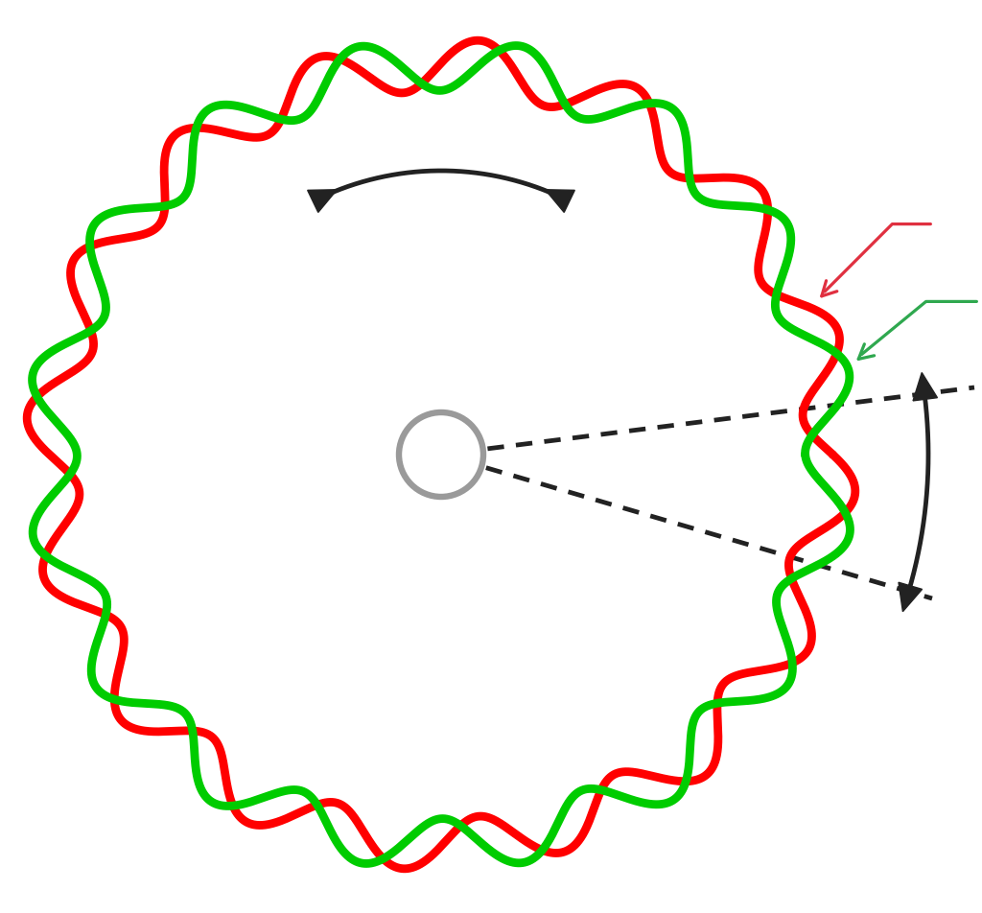
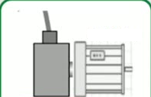
25
Sine/Cosine Encoders
(an industrial application of Motor Control System)
AC Motor
Rotation direction
cos
CCW/CW
sin
Sin/Cos Encoder
Output Signals
Sin/Cos signal period
Sin/Cos
Encoder
Line count =16
(16 signal periods per
revolution)
Incremental rotary position encoders are used in many applications to
measure angular position and speed.
For More Info:
EXTRACTION OF HIGH RESOLUTION POSITION INFORMATION FROM SINUSOIDAL ENCODERS
J. Burke, J. F. Moynhan, K. Unterkofler

Slide 26


Sin/Cos Encoders
26
(an industrial application of Motor Control System)
TIDA-00176
16-bit high-res path
Fine Angle: atan(A/B)
→ Option 1: 16 bit
A, B
SPI
Dual
ADC
A+,A-,B+,B-
Differential Sine and Cosine
A+, A-, B+, B- and Marker R+/R-
SPI
Host MCU Interface
Analog path
Encoder connector
Fine Angle: atan(A/B)
→ Option 2: 12-bit
12-bit
ADC
A, B
Analog
A+,
Position
(Angle)
A+,A-,B+,B-,
A-,
Shielded twisted
pairs cable, up
to 50...150m
R+,R-
B+,
B-,
Coarse Angle
Incremental count
A, B, R
TTL
R+,
eQEP
R-,
Comparators
Up
Un
AC Motor
Sin/Cos
Encoder
24 V
Power
Supplies
5 V
3.3 V
Encoder Supply: 5.25 V
EMC-compliant interface to Sin/Cos incremental position encoder switch
1-VPP Differential analog output signals

Slide 27
Sequence of 5 words
27
+ω
+ω
Positions are defined
Word 3
+ω
as angles
Word 4
Word 2
Sin(ω t)
Cos(ω t)
t=0,1,2,3,....
Word 1
+ω
Word 0

Slide 28
Sequence of 9 words
28
+ω
+ω
Positions are defined
Word 3
+ω
as angles
+ω
Word 4
Word 2
Sin(ω t)
Cos(ω t)
t=0,1,2,3,....
Word 5
Word 1
+ω
+ω
Word 6
Word 0
+ω
Word 7
Word 8
+ω

Slide 29
Sequence of 12 words
29
+ω
+ω
Positions are defined
Word 3
+ω
as angles
+ω
Word 4
Word 2
Sin(ω t)
Cos(ω t)
t=0,1,2,3,....
Word 5
Word 1
+ω
+ω
Word 6
Word 0
+ω
Word 7
Word 11
Using smaller ω value, allow
representation of longer sequences
Word 8
Word 10
(practically use ω = 1/10000)
+ω
Word 9
+ω
+ω
+ω

Slide 30




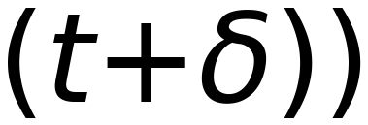
















30
$$sin(ωt)$$
Vector of Pos “t”
$$cos(ωt)$$
Remember:
$$Sin (ω$$
$$(t+δ))$$
$$sin(a+b)=sin (a) cos(b) + cos(a) sin(b)$$
$$cos(a+b)=cos(a) cos(b)-sin(a) sin(b)$$
Vector of Pos “t+δ”
$$cos(ω$$
$$(t+δ))$$
$$sin(ω$$
$$(t+δ))$$
$$=$$
$$sin(ωt +ωδ)$$
$$=$$
$$sin(ωt)$$
$$cos(ωδ)$$
$$+$$
$$cos(ωt)$$
$$sin(ωδ)$$
$$cos(ω$$
$$(t+δ))$$
$$=$$
$$cos(ωt +ωδ)$$
$$=$$
$$cos(ωt)$$
$$cos(ωδ)$$
$$sin(ωt)$$
$$sin(ωδ)$$
$$Sin (ω$$
$$(t+δ))$$
$$cos(ωδ)$$
$$sin(ωδ)$$
$$sin(ωt)$$
From Computer Graphics:
$$cos(ω$$
$$=$$
Rotation Matrix of Vector at
$$(t+δ))$$
$$sin(ωδ)$$
$$cos(ωδ)$$
Pos “t” with angle “ωδ”
$$cos(ωt)$$
Vector of Pos “t+δ”
e.g “ω” , “2ω” , “3ω” , ...
Vector of Pos “t”
Independent of Position “t”

Slide 31























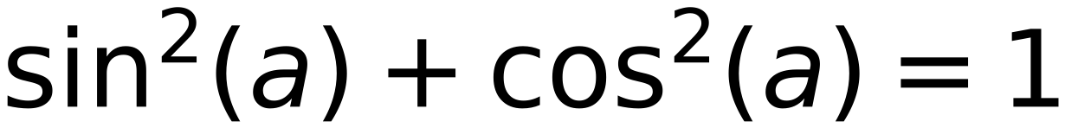











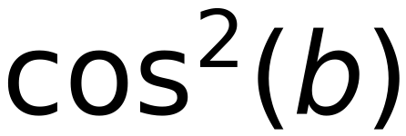
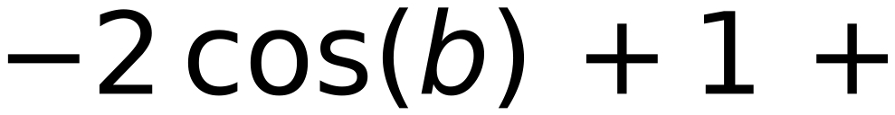
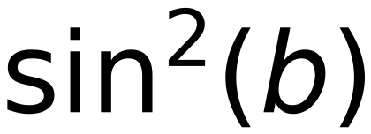


Vector at Pos “t”
Vector at Pos “t+δ”
31
$$sin(ωt)$$
$$Sin (ω(t+δ))$$
$$sin(ωt)$$
$$cos(ωδ)$$
$$+$$
$$cos(ωt)$$
$$sin(ωδ)$$
$$cos(ωt)$$
$$cos (ω(t+δ))$$
$$=$$
$$cos(ωt)$$
$$cos(ωδ)$$
$$-$$
$$sin(ωt)$$
$$sin(ωδ)$$
$$Let$$
$$ωt=a ,$$
$$ωδ=b$$
$$sin(a)$$
$$sin(a)$$
$$cos(b)$$
$$+$$
$$cos(a)$$
$$sin(b)$$
$$cos(a)$$
$$\sin^{2}(a)+\cos^{2}(a)=1$$
$$cos(a)$$
$$cos(b)$$
$$-$$
$$sin(a)$$
$$sin(b)$$
Squared Distance Between
Vector of Pos “t+δ”
and
Vector of Pos “t”
[ Two Consecutive Positions ]
$$[$$
$$sin(a)$$
$$cos(b) +$$
$$cos(a)$$
$$sin(b) -$$
$$sin(a)$$
$$]^{2} + [ -$$
$$sin(a)$$
$$sin(b) +$$
$$cos(a)$$
$$cos(b) -$$
$$cos(a)$$
$$]^{2}$$
$$=$$
$$[ sin(a) (cos(b)-1)+cos(a) sin(b) ]^{2}+ [ -sin(a) sin(b)+cos(a) (cos(b)-1) ]^{2}$$
$$=$$
$$[ sin(a)^{2}(cos(b)-1)^{2}+\cos^{2}(a) \sin^{2}(b)+ 2 sin(a) cos(a) sin(b) (cos(b)-1) ] +$$
$$[ \sin^{2}(a) \sin^{2}(b)+\cos^{2}(a) (cos(b)-1)^{2}- 2 sin(a) cos(a) sin(b) (cos(b)-1) ]$$
$$=$$
$$sin(a)^{2} (cos(b)-1)^{2}+\cos^{2}(a) \sin^{2}(b)+\sin^{2}(a) \sin^{2}(b)+\cos^{2}(a) (cos(b)-1)^{2}$$
$$=$$
$$[ sin(a)^{2}+\cos^{2}(a) ] (cos(b)-1)^{2}+ [ sin(a)^{2}+\cos^{2}(a) ] (\sin^{2}(b) )=(cos(b)-1)^{2}+\sin^{2}(b)$$
$$=$$
Irrespective of Position “t”
$$\cos^{2}(b)$$
$$-2 cos(b) +1 +$$
$$\sin^{2}(b)$$
$$= 2 -2 cos(b) = 2(1-cos(b) )$$
$$=2 (1-cos(ωδ))$$

Slide 32


Sin/Cos Positional Encoder
32
Vector of Dimension “2” to define Position
sin(ωt)
Where “t” is the step (position) and ω is the frequency of trigonometric
cos(ωt)
function Sine/Cosine
This vector can be used to define word position at step “t” , t=0,1,2,3,4,5,6,7,....
›
Values are between -1 and 1 (bounded values)
Distance between vectors representing positions “t” and “t+1” is constant
irrespective of “t” [Distance (Pos1, Pos2) = Distance (Pos90, Pos91)]
›
"t" may take any positive value (No limitation of length of Sequence )
›
Position Vector Length = 2 (Cannot be combined with Word Embedding Vector) ??

Slide 33










Sin/Cos Positional Encoder
33
Positional Vector with Same dimension as Embedding dimension
Vector
Pairs “K”
Index “i”
Word Embedding Dimension “d” [Even Num]
Example:
sin(ωt)
i
0
Position Encoding Dimension “d”
d=100
cos(ωt)
0
Number of Vector Pairs “K”=d/2 [0, 1, 2,... d/2-1]
K=[0 ..49]
1
1
Elements Index “i” [0, 1, 2, ..., d-1]
i=[0 .. 99]
Sin/Cos pairs
2
Vector Represents
Even Index “i” is Sine Term , i=2*k
Sin [0,2,4,...]
Position “t”
3
Odd Index “i” is Cosine Term, i=2*k+1
Cos [1,3,5,...]
2
Any “ω” is accepted
4
Use different “ω” values for different “Pairs”
Select “ω” Value Based on “Pair” index k
5
2k
ω
1
K
2k/d
K
10,000
2k+1
Largest “ω” value = 1
(Used in First Pair)
Smallest “ω” value ≈ 1/10000
(Used in Last Pair)
d-1-1
Note:
“ω” Value depends on Embedding Dimension “d” ONLY
[d/2]-1
“ω” Value does NOT depend on Sequence Length
d-1
dx1

Slide 34
[2] Position Embedding
34
(Similar to Word Embedding)
Position
0
1
2
3
4
5
N-2
N-1
Information
(similar to word tokenization)
Positional
Embedding
Learn
Embedding
Layer to
Position Vectors
(Trained on Position Values)
Vector _{P0}
Vector _{P1}
Vector _{P2}
Vector _{P3}
Vector _{P4}
Vector _{P5}
Vector _{PN-2}
Vector _{PN-1}
Real valued vectors representing positions
(Vector for each position)
Positions > N-1 can NOT be Embedded
(Must Train Embedding on Max Expected Seq. Length)
Vector Length = Word Embedding length

Slide 35
35
Building Transformer Block
Adding
Residual Connections
Layer Normalization
Feed Forward Network

Slide 36
36
Multi Head Self Attention Block
Input:
Word Embedding + Positional Information [First Transformer Block]
Output of Previous Transformer Block [Stacked Transformer Blocks]
Output:
Encoded Vectors of Input Sequence [With Same Input Vectors Dimension]
Remember:
Different Input Sequences should be of Same Length (Fixed Length Sequences)
[Apply Pad or Cut]
Output Sequence is of same Length as Input Sequence
Y₀
Y₁
Y₂
Y₃
Y₄
Y₅
Y_{N-2}
Y_{N-1}
Output of Self
Attention
Multi Head Self Attention Block
Input to Self
Attention
X₀
X₁
X₂
X₃
X₄
X₅
X_{N-2}
X_{N-1}
Word Embedding + Positional Information

Slide 37
Transformer Blocks (stacked over Multi-Head)
37
Encoder
Output
Decoder
Probabilities
Softmax
WE
ARE
HERE
Linear
Add & Norm
Multi-Head Attention
Add & Norm
Feed
Forward
Scaled Dot-Product
Attention
Feed
Forward
Add & Norm
Add & Norm
Linear
Add & Norm
Multi-Head
Attention
Add & Norm
Multi-Head
Attention
Feed
Forward
MatMul
Feed
Forward
N x
Concat
V
K
Q
SoftMax
N x
Add & Norm
Add & Norm
Add & Norm
Add & Norm
Masked
Multi-Head
Attention
Multi-Head
Attention
Mask (opt.)
Scaled Dot-Product
Attention
h
Multi-Head
Attention
V
V
K
Q
Scale
Linear
Linear
Linear
K
Q
Positional
Encoding
Positional
Encoding
MatMul
Input
Embedding
Output
Embedding
Q
K
V
V
K
Q
Inputs
Outputs
(shifted right)

Slide 38


38
Residual Connections and Normalization
Adding Residual Connection:
Word Embedding + Positional Information [First Transformer Block]
Output of Previous Transformer Block [Stacked Transformer Blocks]
Adding “LAYER” Normalization
Encoded Vectors of Input Sequence [With Same Input Vectors Dimension
Y₁
Y₂
Y₃
Y₄
Y₅
Y₆
Y_{N-1}
Y_{N}
Layer Normalization (NOT Batch Normalization)
+
+
+
+
+
+
+
+
Output of Self
Y'₁
Y'₂
Y'₃
Y'₄
Y'₅
Y'₆
Y'_{N-1}
Y'_{N}
Attention
Multi Head Self Attention Block
Residual
Connections
Input to Self
Attention
X₁
X₂
X₃
X₄
X₅
X₆
X_{N-1}
X_{N}
Word Embedding + Positional Information

Slide 39
Normalization
39
The behavior of machine learning algorithms changes when the input distribution changes.
{Covariate shift }
layer weights changes
Outputs of Activation functions
Inputs to the next layer,
during training steps
of each layer change
(With different Input distribution)
Conclusion:
Input distribution of each layer changes with each step .
The basic idea behind Normalization is to:
Limit covariate shift by normalizing the activations of each layer
Normalization:
Transforming the inputs to be
Zero mean and unit variance.
Normalization allows each layer to:
learn on a more stable distribution of inputs,
Accelerate the training of the network (don't stick with very small learning rates).

Slide 40

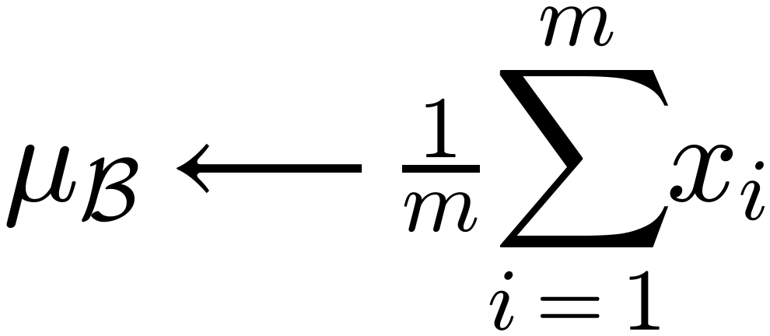
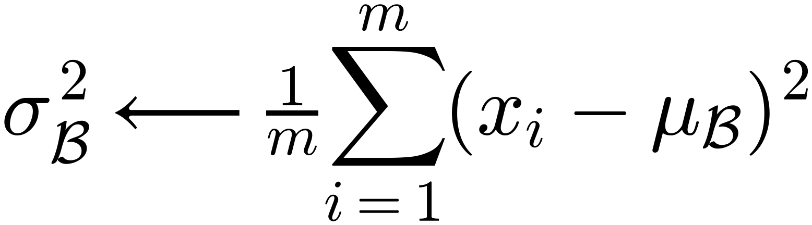
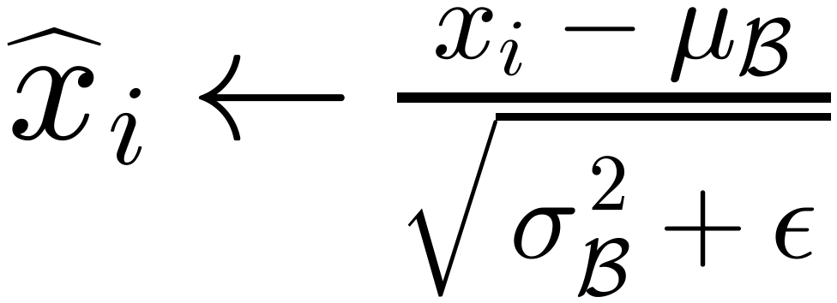
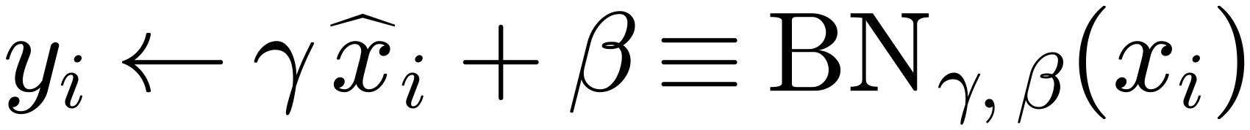
Normalization Parameters
40
Instead of restricting the Activations of each layer to be strictly Zero mean and unit variance,
Normalization allows the network to
learn parameters γ and β that can convert the mean and
variance to any value that Minimizes Loss.
$$Input: Values of x over a mini-batch: ℬ=\{x_{1…m}\};$$
$$Parameters to be learned: γ, β$$
$$Output: \{y_{i}={BN}_{γ,β}(x_{i})\}$$
$$μ_{ℬ}⟵\frac{1}{m}\sum_{i=1}^{m}{x_{i}}$$
// mini-batch mean
$$σ_{ℬ}^{2}⟵\frac{1}{m}\sum_{i=1}^{m}{(x_{i}-μ_{ℬ})^{2}}$$
// mini-batch variance
$${\hat{x}}_{i}←\frac{x_{i}-μ_{ℬ}}{\sqrt{σ_{ℬ}^{2}+ε}}$$
// normalize
$$y_{i}←γ {\hat{x}}_{i}+β≡{BN}_{γ,β}(x_{i})$$
// scale and shift

Slide 41
Normalization
41
Normalization
of
Activations
Weights
Outputs
Batch Normalization
Weight Normalization
Instance Normalization
Group Normalization
Layer Normalization

Slide 42
42
Batch Data (Feature Vectors)
Feature Vectors of :
FIVE Input Samples [mini-Batch]
Feature Vector of One Input
Feature Vectors of One Input Sample
Using 4 filters [ 4 Channels]
Sample (Using one filter)
(Using 4 filters) [ 4 Channels]
Feature Vector
Batch size
(5 samples)
Channels
(4 Filters)

Slide 43
Batch Normalization
43
Batch Normalization
Calculate (then Normalize) μ, σ
for ALL Samples in the batch
Feature Vector
(for each channel)
Batch size
Channels
Batch Normalization Calculate Mean and Variance of Each Mini-Batch instead of
Calculating Mean and Variance of the Whole Data.
The mean and variance will differ from mini-batch to another (Source of Error).
Mini Batch Size should be large enough to minimize “batching” effect. (Constrain)

Slide 44
Layer , Group, and Instance Normalization
44
Sample Based
Normalization
Samples
Feature Vector
Batch size
Channels
Group Normalization
Instance Normalization
(Group of Channels)
Calculate (then Normalize) μ, σ for ONE Channel in
General Case
ONE Sample (Output of ONE Filter)
Channels
Layer Normalization
Transformer choice
Calculate (then Normalize) μ, σ for ALL Channels in the Same Sample (Input to Same Layer)

Slide 45
Feed Forward Neural Network
45
Feed Forward Network for each Vector
(After applying Normalization)
One Hidden Layer with RELU Activation,
[Size: at least double Input dimension]
Linear Activation Output Layer
[Size: same Input Vector dimension]
Y₁
Y₂
Y₃
Y₄
Y₅
Y₆
Y_{N-1}
Y_{N}
Feed Forward Networks [ One Hidden with RELU Activation]
RELU
RELU
RELU
RELU
RELU
RELU
RELU
RELU
Y₁
Y₂
Y₃
Y₄
Y₅
Y₆
Y_{N-1}
Y_{N}
Layer Normalization
+
+
+
+
+
+
+
+
Output of Self
Y₁
Y₂
Y₃
Y₄
Y₅
Y₆
Y_{N-1}
Y_{N}
Attention
Multi Head Self Attention Block
Residual
Connections
Input to Self
Attention
X₁
X₂
X₃
X₄
X₅
X₆
X_{N-1}
X_{N}
Word_Embedding + Positional_Information

Slide 46
46
Final
Output
46
Y₀
Y₁
Y₂
Y₃
Y₄
Y₅
Y_{N-2}
Y_{N-1}
Layer Normalization
+
+
+
+
+
+
+
+
Y₀
Y₁
Y₂
Y₃
Y₄
Y₅
Y_{N-2}
Y_{N-1}
Feed Forward Networks [ One Hidden with RELU Activation]
Residual
Connections
RELU
RELU
RELU
RELU
RELU
RELU
RELU
RELU
Y₀
Y₁
Y₂
Y₃
Y₄
Y₅
Y_{N-2}
Y_{N-1}
Layer Normalization
+
+
+
+
+
+
+
+
Output of Self
Y₀
Y₁
Y₂
Y₃
Y₄
Y₅
Y_{N-2}
Y_{N-1}
Attention
Multi Head Self Attention Block
Residual
Connections
Input to Self
Attention
X₀
X₁
X₂
X₃
X₄
X₅
X_{N-2}
X_{N-1}
Word_Embedding + Positional_Information

Slide 47



null
Block Output
Y₀
Y₁
Y₂
Y₃
Y₄
Y₅
Y_{N-2}
Y_{N-1}
47
Layer Normalization
+
+
+
+
+
+
+
+
Y₀
Y₁
Y₂
Y₃
Y₄
Y₅
Y_{N-2}
Y_{N-1}
Feed Forward Networks [ One Hidden with RELU Activation]
RELU
RELU
RELU
RELU
RELU
RELU
RELU
RELU
Encoder Block
Y₀
Y₁
Y₂
Y₃
Y₄
Y₅
Y_{N-2}
Y_{N-1}
Layer Normalization
+
+
+
+
+
+
+
+
Y₀
Y₁
Y₂
Y₃
Y₄
Y₅
Y_{N-2}
Y_{N-1}
Multi Head Self Attention Block
Block Input
X₀
X₁
X₂
X₃
X₄
X₅
X_{N-2}
X_{N-1}

Slide 48
null
Block Output
Y₀
Y₁
Y₂
Y₃
Y₄
Y₅
Y_{N-2}
Y_{N-1}
48
Layer Normalization
Layer Normalization (NOT Batch Norm)
Add & Norm
+
+
+
+
+
+
+
+
Feed
Forward
Y₀
Y₁
Y₂
Y₃
Y₄
Y₅
Y_{N-2}
Y_{N-1}
Feed Forward Networks [ One Hidden with RELU Activation]
RELU
RELU
RELU
RELU
RELU
RELU
RELU
RELU
Encoder Block
Y₀
Y₁
Y₂
Y₃
Y₄
Y₅
Y_{N-2}
Y_{N-1}
Add & Norm
Layer Normalization
Layer Normalization (NOT Batch Norm)
Multi-Head
Attention
+
+
+
+
+
+
+
+
Y₀
Y₁
Y₂
Y₃
Y₄
Y₅
Y_{N-2}
Y_{N-1}
Positional
Encoding
+
V
K
Q
Multi Head Self Attention Block
Input
Embedding
Inputs
Block Input
X₀
X₁
X₂
X₃
X₄
X₅
X_{N-2}
X_{N-1}

Slide 49
Transformer Stacked Encoder Blocks
49
Encoder
Output
Y₀
Y₁
Y₂
Y₃
Y₄
Y₅
Y_{N-2}
Y_{N-1}
Encoder Block M
Transformer
Encoder
Encoder Block 2
Encoder Block 1
Encoder Block 0
Encoder
Input
X₀
X₁
X₂
X₃
X₄
X₅
X_{N-2}
X_{N-1}
Word Embedding
Embedding
Words & Pos.
Positional Encoding / Embedding
Input Seq
Word 0
Word 1
Word 2
Word 3
Word 4
Word 5
Word N-2
Word N-1

Slide 50
50
Transformer Decoder

Slide 51
Encoder – Decoder Transformer
51
Encoder
Output
Decoder
Probabilities
Decoder Only
Softmax
Decoder Only
Linear
Add & Norm
Feed
Forward
Add & Norm
Add & Norm
Multi-Head
Attention
Feed
Forward
Encoder –
Decoder
Attention
Nx
N x
Add & Norm
Add & Norm
Masked
Multi-Head
Attention
Multi-Head
Attention
Adding Mask
≈
K
V
Q
Positional
Encoding
Output
Embedding
Output
Embedding
Positional
Encoding
Inputs
Outputs
(shifted right)

Slide 52
52
Multi-head Encoder-Decoder
Attention Block
Residual Connection and Layer Normalization
Feed Forward Networks [ One Hidden with RELU Activation]
Masked Multi-head Self
Attention Block
Residual Connection and Layer Normalization
K
Encode
Decoder
Attention
Encode
Decoder
Attention
Encode
Decoder
Attention
Encode
Decoder
Attention
Encode
Decoder
Attention
V
Y
Y
Y
Q
Q
Q
Q
Q
Transformer Encoder
Residual Connection and Layer Normalization
Masked
Multi-Head
Self Attention
Masked
Multi-Head
Self Attention
Masked
Multi-Head
Self Attention
Masked
Multi-Head
Self Attention
Masked
Multi-Head
Self Attention
I
feel
Sick
Word and Position Encoding
SOS = Start Of Sentence
SOS
Je
me
sens
malade

Slide 53
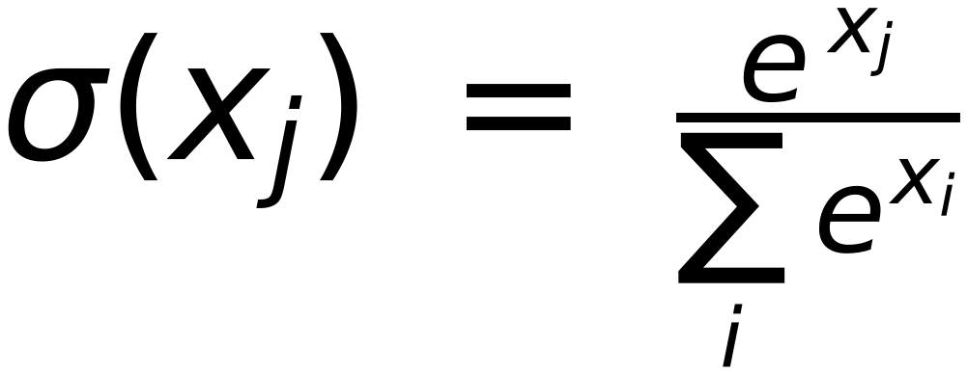
Self Attention Look Ahead Mask
53
(Used in Decoder first Block )
Softmax
$$σ(x_{j})=\frac{e^{x_{j}}}{\sum_{i}{e^{x_{i}}}}$$
SOS
Je
me
sens
malade
SOS
0
−∞
−∞
−∞
−∞
Je
0
0
−∞
−∞
−∞
me
0
0
0
−∞
−∞
sens
0
0
0
0
−∞
malade
0
0
0
0
0
Mask Values are ADDED to Masked (Scaled) Values
Addition of “0” does not change the original values, consequently no effect on Softmax output
Addition of “-inf” gets “Zero” output of Softmax, leaving zero attention scores for future Words.

Slide 54


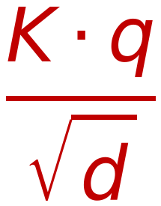
Self Attention Mechanism for Decoder (Adding Mask)
54
-−∞
*
Z
Similarity
Probabilities
Weighted SUM
Dot
Product
K·q
$$\frac{K⋅q}{\sqrt{d}}$$
Σ
Mask
Z₄
W_{k}^{(r)}
K₄
-−∞
0
×
V₄
W_{v}^{(r)}
Z₄
W_{k}^{(r)}
Soft max
W_{v}^{(r)}
Z₃
K₃
-−∞
×
V₃
Z₃
Scaling by √d
ς
Z₂
W_{k}^{(r)}
K₂
0
×
V₂
W_{v}^{(r)}
Z₂
Z₁
W_{k}^{(r)}
K₁
0
×
V₁
W_{v}^{(r)}
Z₁
q₂
Look Ahead
Mask
W_{q}^{(r)}
1×d
W
=
Z₁
Z₂
Z₃
Z₄
d×d
1×d
d: Embedding Length

Slide 55
Encoder-Decoder Attention Mechanism (In Decoder)
55
(Self Attention of word Z₂ w.r.t All words in Sentence ( Y₁, Y₂, Y₃, Y₄ )
O
Similarity
Probabilities
Weighted SUM
From Encoder
Output
Dot
Product
K.q
$$\frac{K⋅q}{\sqrt{d}}$$
Σ
From Encoder
Output
Y₄
W_{k}^{(r)}
K₄
×
V₄
W_{v}^{(r)}
Y₄
Y₃
W_{k}^{(r)}
K₃
Soft max
×
V₃
W_{v}^{(r)}
Y₃
Scaling by √d
ς
Y₂
W_{k}^{(r)}
K₂
×
V₂
W_{v}^{(r)}
Y₂
Y₁
W_{k}^{(r)}
K₁
×
V₁
W_{v}^{(r)}
Y₁
q₂
W_{q}^{(r)}
W
Z₁
Z₂
Z₃
Z₄
From Decoder
Self Attention Layer
1×d
=
1×d
d×d
d: Embedding Length

Slide 56
Decoder Final Output
56
Probability of each word in Vocab
Vocab Size
Softmax
Vocab Size
Linear Projection
Last Decoder Block

Slide 57
57
Softmax
Y₀
Y₁
Y₂
Y₃
Y₄
Y₅
Y_{N-2}
Y_{N-1}
Encoder Block M
Residual Connection and Layer Normalization
K
Feed Forward Networks - One Hidden with RELU Activation
Residual Connection and Layer Normalization
Encoder
Decoder
Attention
Encoder
Decoder
Attention
Encoder
Decoder
Attention
Encoder
Decoder
Attention
Encoder
Decoder
Attention
Decoder
Encoder
Encoder Block 2
V
Residual Connection and Layer Normalization
Feed Forward Networks - One Hidden with RELU Activation
Encoder Block 1
Q
Residual Connection and Layer Normalization
Encoder
Decoder
Attention
Encoder
Decoder
Attention
Encoder
Decoder
Attention
Encoder
Decoder
Attention
Encoder
Decoder
Attention
Encoder Block 0
Residual Connection and Layer Normalization
Feed Forward Networks - One Hidden with RELU Activation
Q
Residual Connection and Layer Normalization
X₀
X₁
X₂
X₃
X₄
X₅
X_{N-2}
X_{N-1}
Encoder
Decoder
Attention
Encoder
Decoder
Attention
Encoder
Decoder
Attention
Encoder
Decoder
Attention
Encoder
Decoder
Attention
Word Embedding
Encoder
Positional Encoding / Embedding
Residual Connection and Layer Normalization
Q
Decoder
Multi-Head
Self-Attention
Multi-Head
Self-Attention
Multi-Head
Self-Attention
Multi-Head
Self-Attention
Multi-Head
Self-Attention
Attention
Word 0
Word 1
Word 2
Word 3
Word 4
Word 5
Word N-2
Word N-1
Word and Position Encoding
SOS
Je
ne
suis
faisait

Slide 58
58
Transformer Encoder
as a Classifier

Slide 59
Output Classes
C₁
C₂
C₃
59
Softmax Layer
Softmax
Softmax
Softmax
Σ
Σ
Σ
Single vector representing
the whole sequence
Global Average Pooling
Output
Sequence
Y₀
Y₁
Y₂
Y₃
Y₄
Y₅
Y_{N-2}
Y_{N-1}
Transformer Block
Transformer Block
Transformer Encoder
Transformer Block
Input Sequence
Word
Embedding
Vectors
X₀
X₁
X₂
X₃
X₄
X₅
X_{N-2}
X_{N-1}
+
Position
Information
Vectors
Vector_{P0}
Vector_{P1}
Vector_{P2}
Vector_{P3}
Vector_{P4}
Vector_{P5}
Vector_{PN-2}
Vector_{PN-1}

Slide 60
What is Next (as of 2020)
60
GPT-1 and GPT-2 (Generative Pre-trained Transformers)
Radford et al., OpenAI. June 2018 and February 2019.
BERT (Bidirectional Encoder Representations from Transformers)
Devlin et al., Google AI Language. May 2019.
RoBERTa (Robustly Optimized BERT Approach)
Liu et al., Facebook AI. June 2019.
Transformer-XL: Attentive Language ModelsBeyond a Fixed-Length Context
Zhang Dai et al. Carnegie Mellon University and Google Brain
T5 (Text-to-Text Transfer Transformer)
GPT-3 (175 Billion Parameter, Beta Release June 2020)

