Slide 1
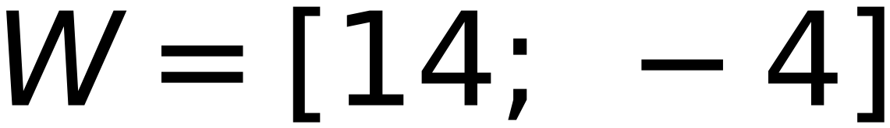
x₁
x₂
x₃
x₄
x₅
x₆
4
Step η = 2
Z₁
Z₁
Z₁
44
Initial W =
(1)
(2)
(1)
(5)
(6)
(6)
-2
Check classes of
-2
(0)
(7)
(3)
(1)
(1)
(2)
(4)
(5)
(6)
(0)
(6)
(2)
C₁
C₁
C₁
C₂
C₂
C₂
C₁ positive, C₂ negative, Zero is unaccepted
Upgraded Vectors (from Top)
x₁
x₂
x₃
x₄
x₅
x₆
⇒ Update Weight
(1)
(1)
(1)
(1)
(1)
(1)
(1)
(2)
(1)
(5)
(6)
(6)
(1)
(2)
(4)
(5)
(6)
(6)
C₁
C₁
C₁
C₂
C₂
C₂
⇒ Update Weight
Iteration 3
⇒ Update Weight
⇒ Keep same Weight
⇒ Keep same Weight
⇒ Keep same Weight

