Slide 1
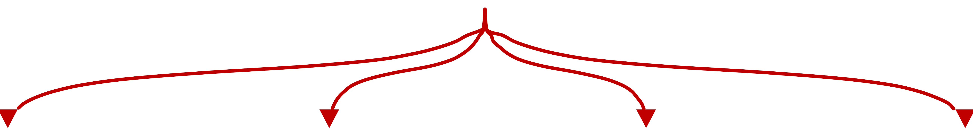
7
Major Domains
of
Machine/Deep Learning
Time Series
Computer
Vision
Speech
Natural
Language
Processing

