Slide 1
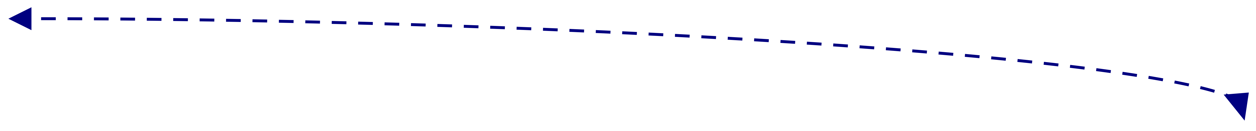

The Complete Deep Learning Model
18
Training
Data
End-To-End model
Pre
processing
Feature
Extraction
Feature
Selection
Classification
Classifier Output
Deeeeeeep Model
Based on Training Data
(Model Choice)
Model choose Best
feature for given
training data
Model Reduces
the features
(if required)
Based on
Trained Model
Classify using
Trained Model
No Interaction from Human
It is Based on Training Data

