Slide 1
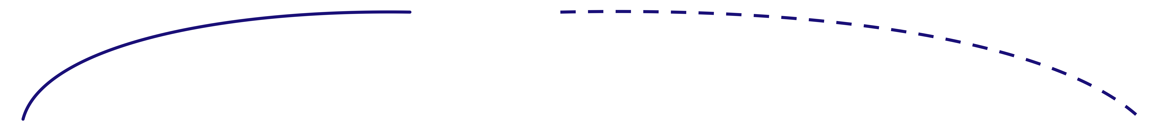
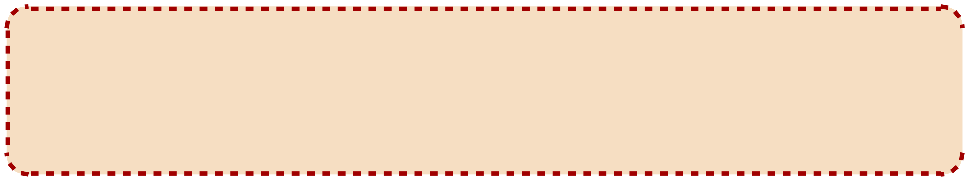
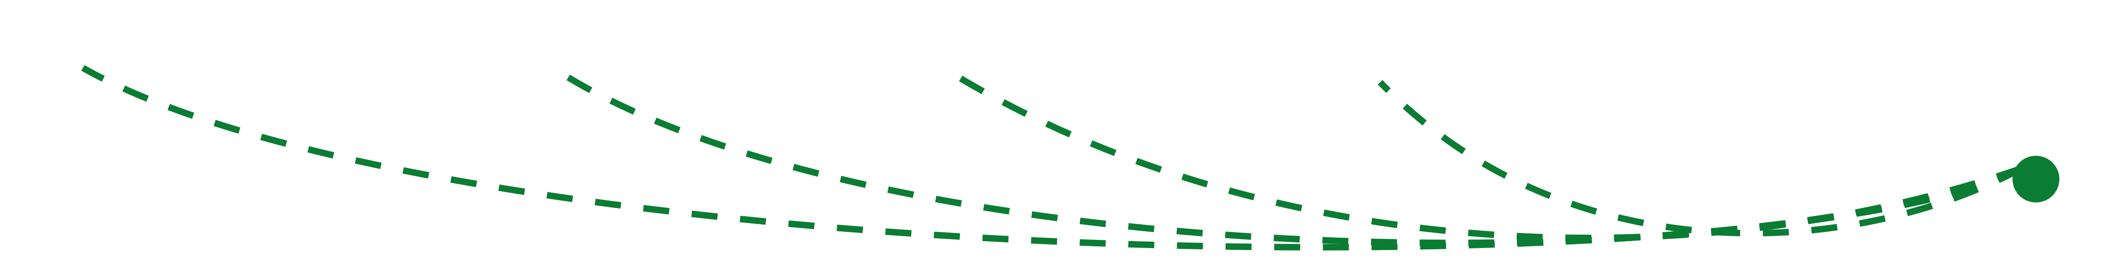
The Complete Deep Learning Model
19
Training
Data
Input
Samples
Pre
processing
Feature
Extraction
Feature
Selection
Classification
Predicted
Labels
Prediction Error
Samples
Labels
(Loss Function)
Update Model Parameters in order to MINIMIZE error
(difference between model prediction and Actual labels

