Slide 1
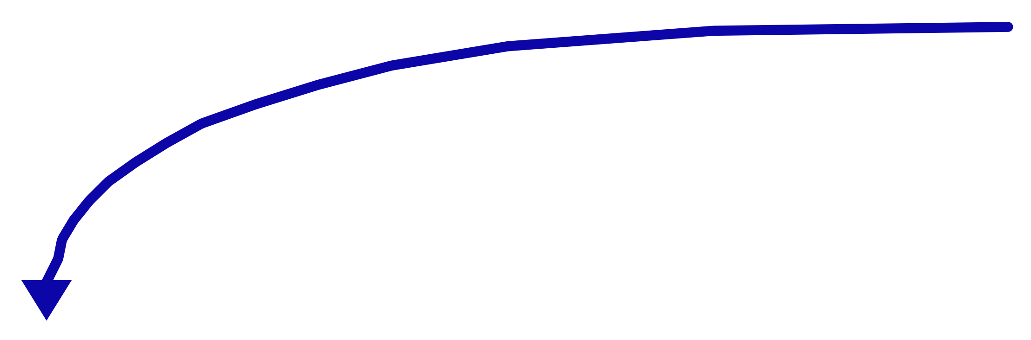
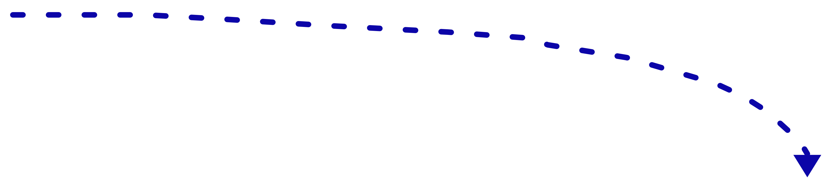
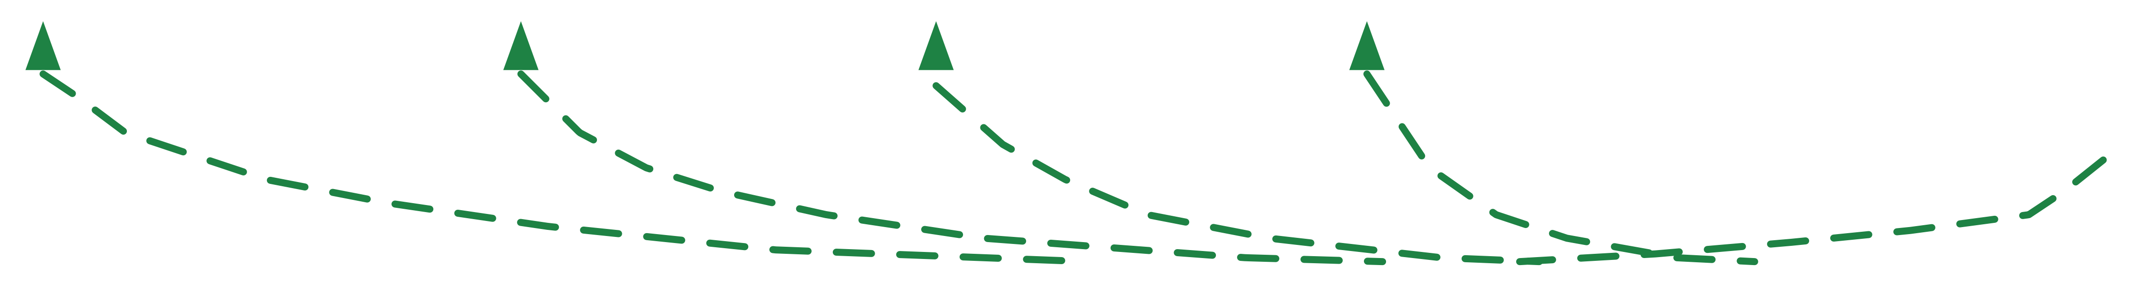
The Complete Deep Learning Model
20
Training
Data
Prediction Error
(Loss Function)
Input
Samples
Pre
processing
Feature
Extraction
Feature
Selection
Classification
Predicted
Labels
Samples
Labels
Update Model Parameters in order to MINIMIZE error
(difference between model prediction and Actual labels
The BIG
challenge

