Slide 1
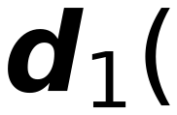


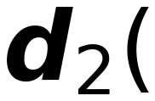

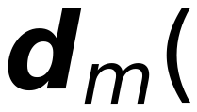

Visualization of Single Layer Perceptron
23
Σ
>0 Class I
<0 Not Class
I
w₁₁
x₁
w₁₂
x₂
w₁₃
w₂₁
w₂₂
Σ
>0 Class II
<0 Not Class
II
x₃
w₂₃
...
w_{1n}
w_{2n}
Multi-Class
b₂
...
Classification
x_{n}
b₁
w_{m1}
w_{m2}
1
w_{m3}
w_{mn}
b_{m}
Σ
>0 Class m
<0 Not Class
m

