Slide 1

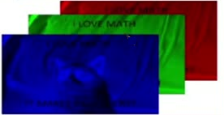

29
Spatial Structure of Image
Images are 2-D
k-D if you also count the extra channels
RGB, hyperspectral, etc.
What does a 2-D input really mean?
Neighboring variables are locally correlated

