Slide 1
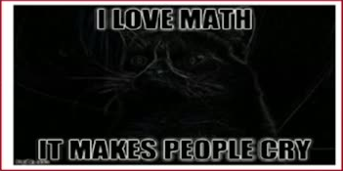
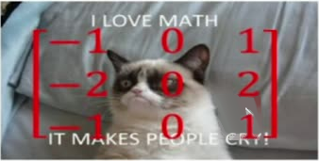
30
Apply filter on 2-D gray image (K=1 Channel)
e.g. Sobel 2-D filter

