Slide 1

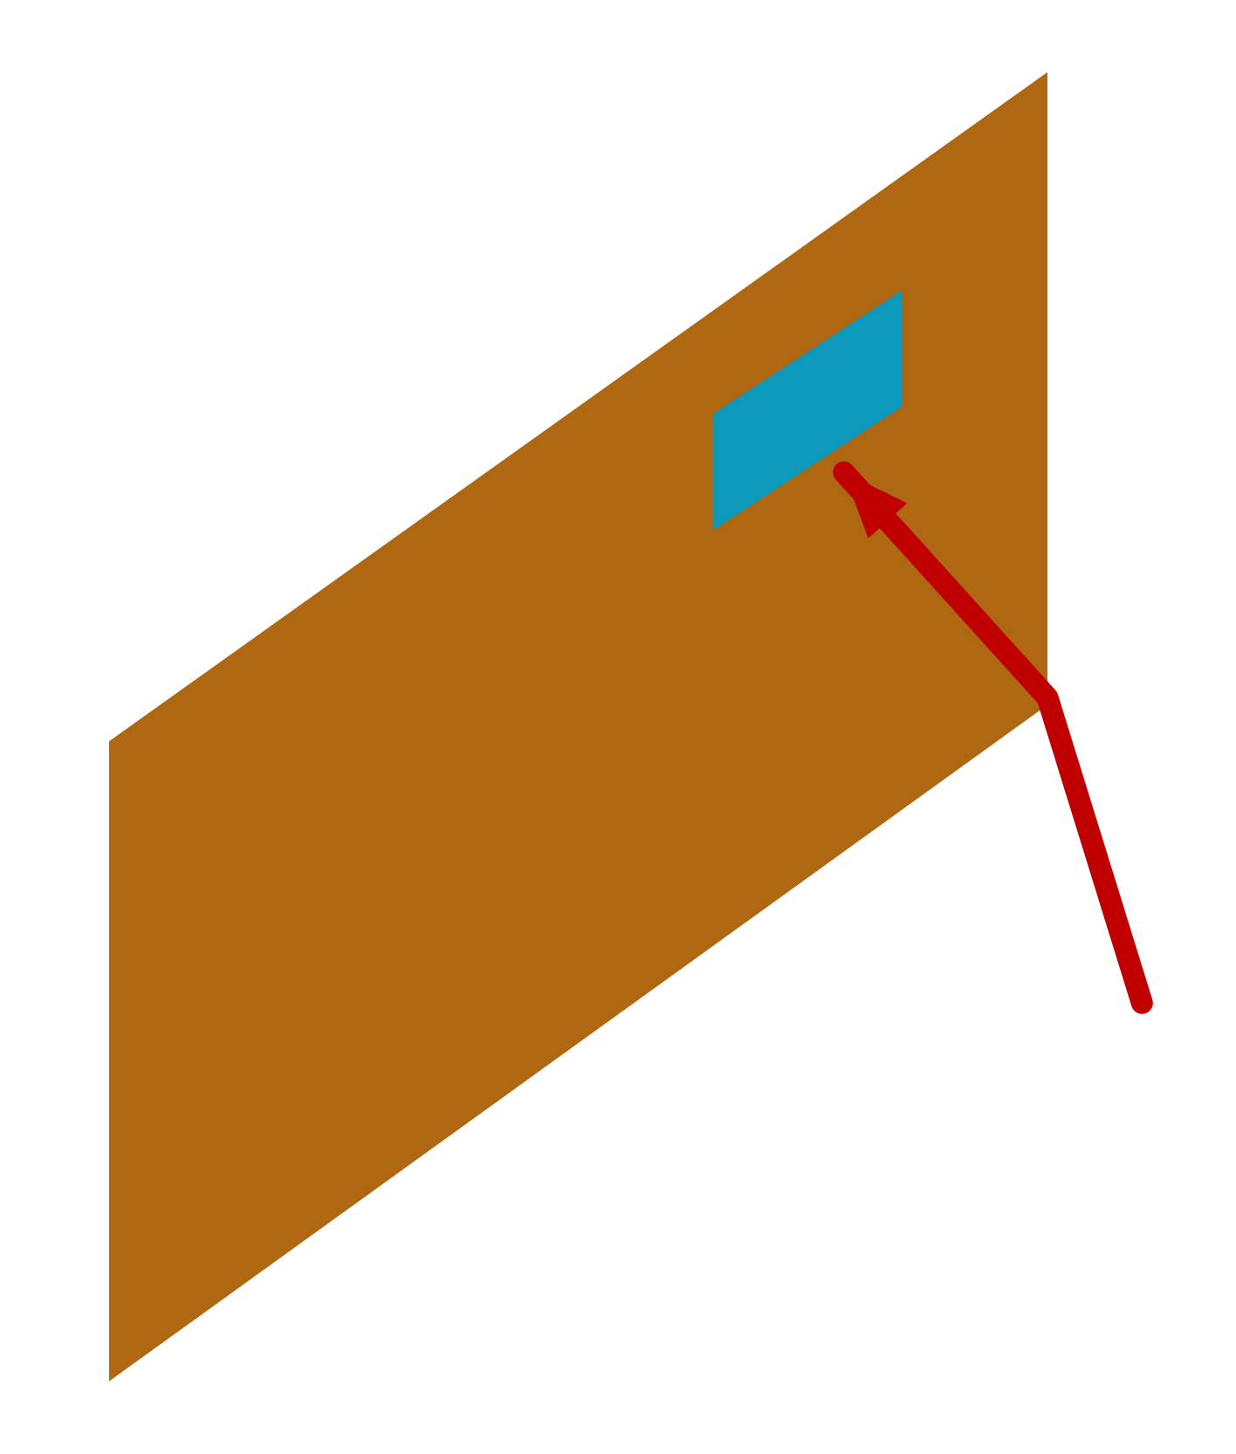

32
Where to Get Filters for Recognition
If images are 2-D,
parameters should also be organized in 2-D
That way they can learn the local
2-D Image
correlations between input variables
That way they can “exploit” the spatial
nature of images

