Slide 1
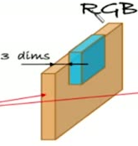

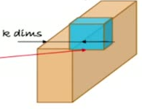

33
Where to Get Filters for Recognition
Similarly, if images are k-D, parameters should also be k-D
For K=3 (RGB), use K-D filter (third dim >> K=3)
For K=9 (Satellite images) use 9-D filter (3
dim = 9)
...etc

