Slide 1
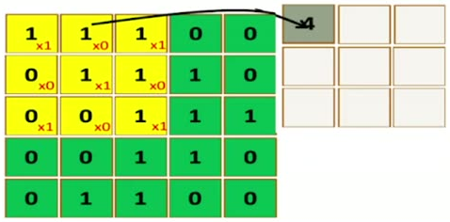
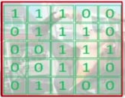
How to Apply Filter on image
35
Image
Filter
1 | 0 | 1
0 | 1 | 0
1 | 0 | 1
Apply Filter on Image is a Dot product between image values and filter values
(can be modeled by PERCEPTRON )

