Slide 1

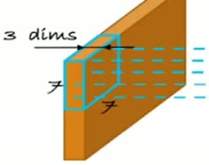
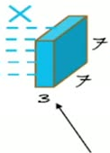

36
How many Parameters are in the RGB
Image filter ( K=3 )
How many weights for this neuron?

