Slide 1
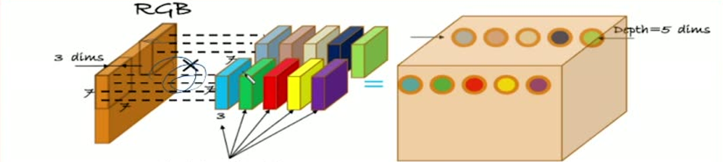
37
How many filter can we apply on the image
We can Apply multiple filters on the same location (e.g. 5 different filters on
the same location. For Example:
[ one to detect edges, one to detect lines, one to detect curves, ...etc)
How many weights for these 5 neurons?

