Slide 1

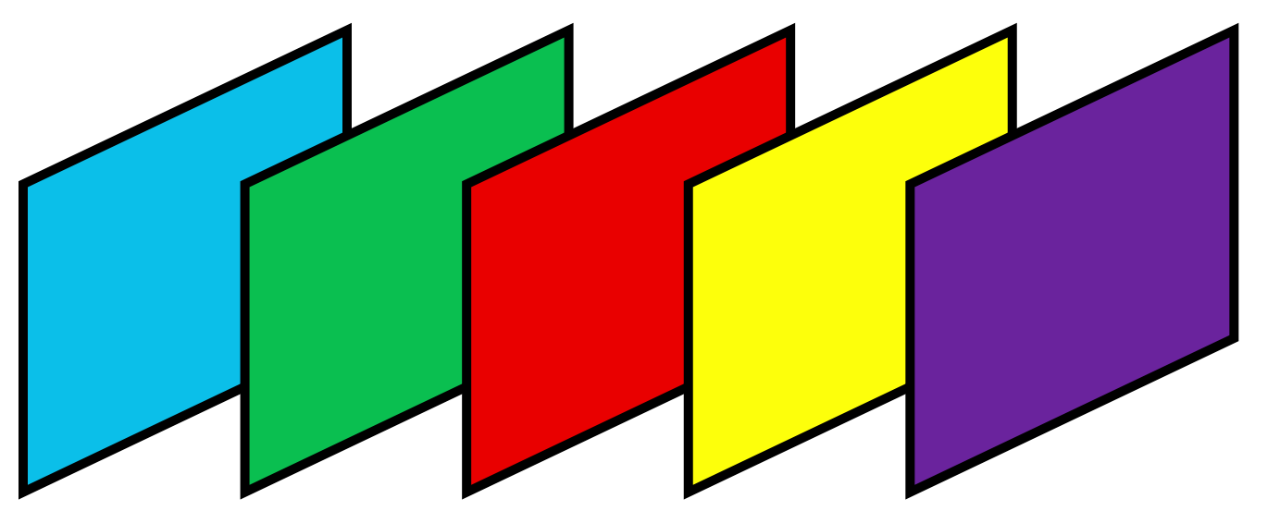
Filters parameters
38
Number of parameters for different filters applied to same location in the image
= Filter size (2-D) * Number of channels (K) * number of different filters
= 7*7 * 3 * 5 =735
RGB
3 dims
X
7
7
7
7
7
3
735 weights

