Slide 1
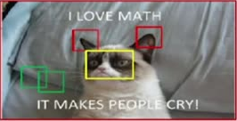
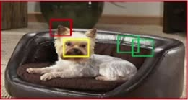
How many filters we should apply
39
Hypothesis
Natural images are stationary
Visual features are common for different parts of one or multiple image
Conclusion
It is not required to use different filters for different spatial locations in the image
(in other words, apply same filter for ALL positions in the image)
Apply Red filter to detect ears in the whole image (not necessarily in the middle of the image)
Apply Yellow filter to detect nose in the whole image
Apply Green filter to detect edges in the whole image

