Slide 1
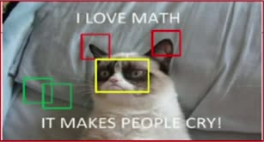
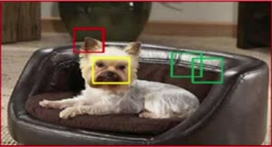
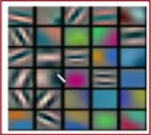
40
How many filters we should apply
Example: 30 different filters
Each filter can detect different information from the image
Apply those 30 filters on the image (each one should be
applied on the whole locations on the image)

