Slide 1
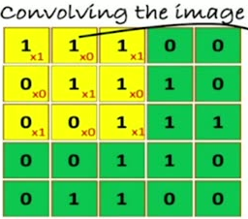
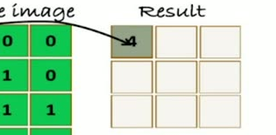
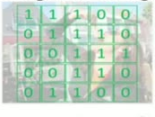

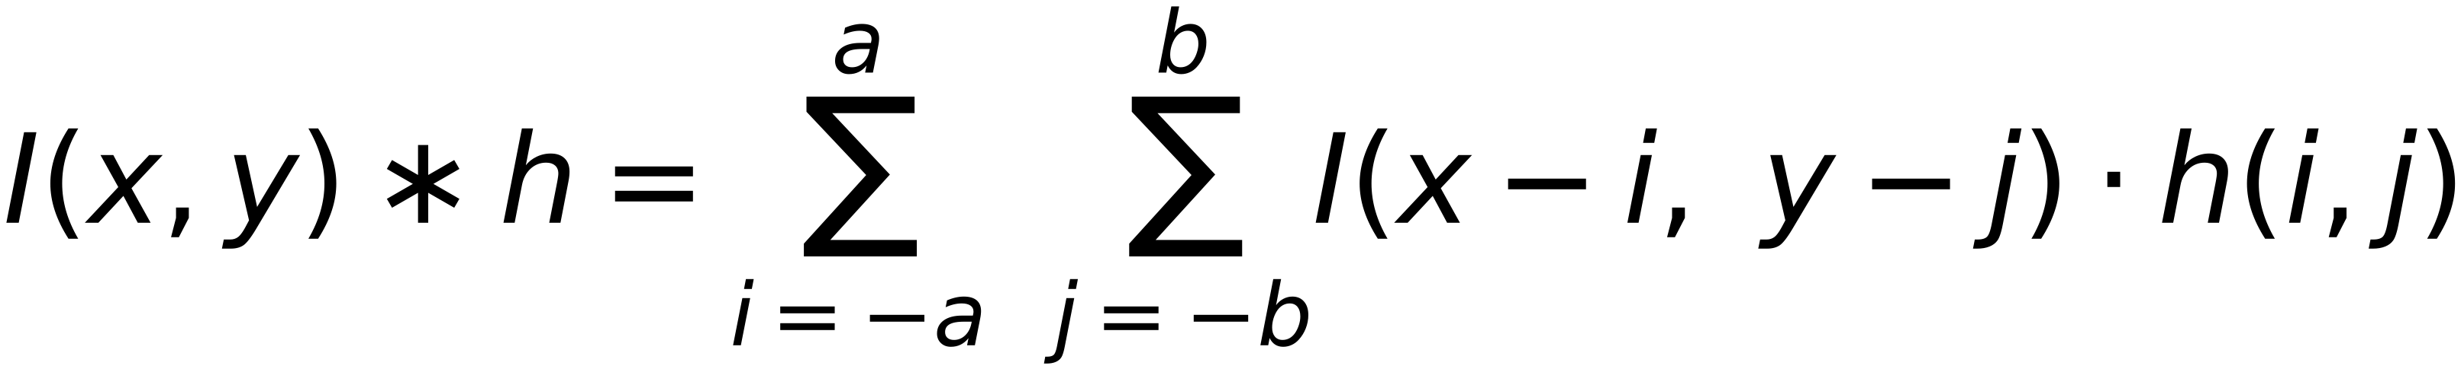
41
The Convolution Process
Original image
Convolutional filter 1
1 | 0 | 1
0 | 1 | 0
1 | 0 | 1
a=1,
b=1
$$I(x,y)∗h=\sum_{i=-a}^{a}{ \sum_{j=-b}^{b}{I(x-i, y-j)⋅h(i,j)}}$$
Image: I (x,y)
Filter: h (-a:a , -b:b) (odd dimension)
Scan the original image using the 3x3 filter
Move the filter ONE pixel (Right, Left, Up, Down) and Re-Calculate

