Slide 1
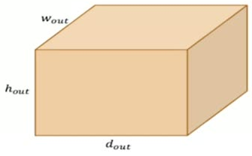
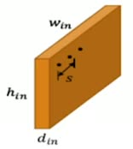
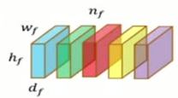






















42
Output dimensions of Convolution?
h
hight
w
Width
d
Depth
f
Filter
n
Filters Count
S
Stride

