Slide 1
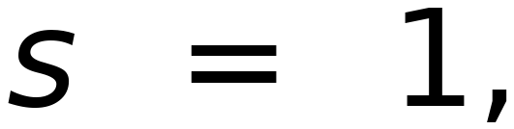
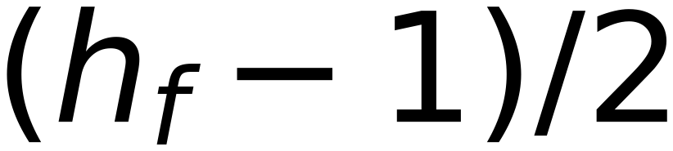
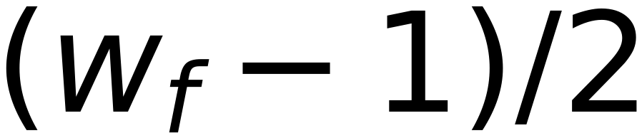


44
Solution? Zero-padding! , Others !!
For
surround
the
image
with
and
layers
of
0
0
0
0
0
0
0
0
0
1
1
1
0
0
0
1
1
2
0
0
0
0
1
1
1
0
0
0
1
1
1
0
0
0
1
0
0
0
1
1
1
0
0
1
1
0
0
1
2
1
0
0
0
1
1
0
0
1
1
1
1
0
2
1
0
0
0
1
1
0
0
0
0
1
1
3
0
0
0
0
0
0
0
0
Original 5x5
After padding ONE pixel (surrounding the image) it will be 7x7
After apply one filter of size 3x3 , output will be 5x5 again
Do the same for next applied filter

