Slide 1
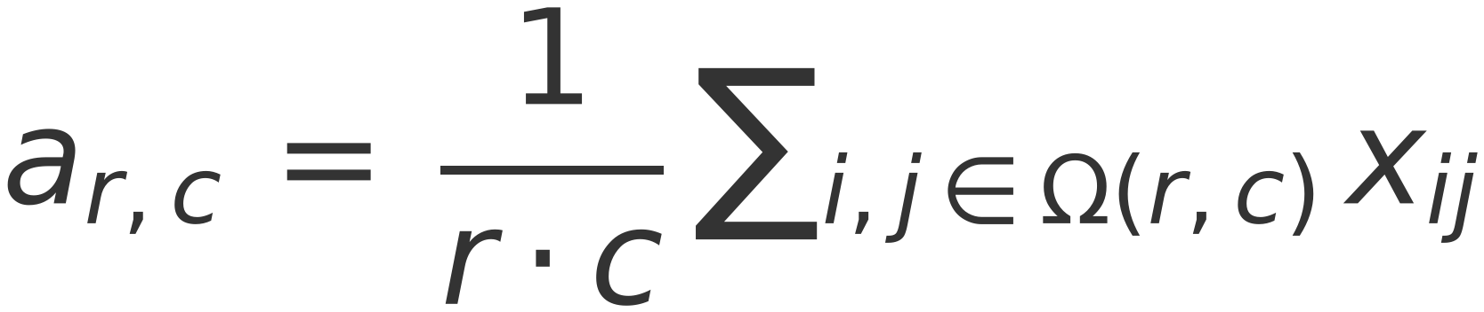
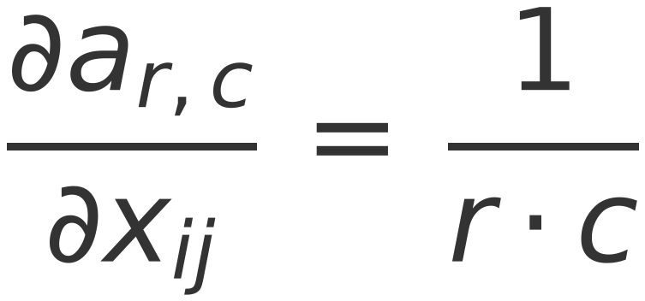

47
AVERAGE POOLING Layer (Take Average Value)
It is a new Module (Average-POOLING module)
Output = 1/r c * Summation (each_input_pixel * 1)
Required to define its input, its output, and Gradient of Output w.r.t input
Run a sliding window of size [h_{f} , w_{f} ]
At each location keep the average value
Activation function:
Gradient w.r.t. input
Where:
r
Row
1
4
1
6
c
Column
2
3
0
9
5
8
f
filter
⇒
h
Height
1
2
7
1
4
5
w
width
4
1
0
2

