Slide 1

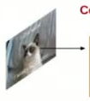
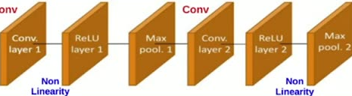
Standard Neural Network (NN) vs Convolutional
48
Neural Network (ConvNet/CNN)
Neural Network
Flatten
(1-D)
FC
FC
FC
FC
O/P
Layer 1
Layer 2
Layer 3
Layer 4
Layer 5
Loss
Convolutional Neural Network
FC
O/P
Layer 5
Layer 6
Loss
Deep Learning (too Many Layers)

