Slide 1



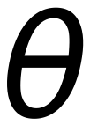
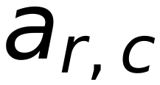














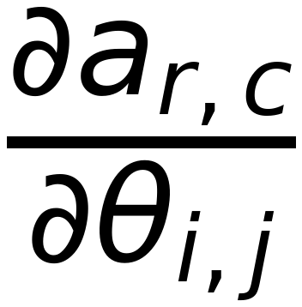







Apply Convolution as a NEW MODULE
45
Important
Since Convolution is a DOT product (between filter values and corresponding image values),
It can be applied as if it is a NN Layer
Input: image values, Weights : filter values, Activation: Linear, Bias:0
Remember: for training, it is required to have the gradient of Output w.r.t both Input and
weights
Activation function
θ_{ij}
⇒ Filter weights
Weights: filter values
r, c
⇒ row, column
Essentially a dot product, similar to linear layer
a_{rc}
⇒ Activation value = Σ
θ
⇒ Vevtor of all weights
Gradient w.r.t. the parameters
Input: pixel values

