Slide 1
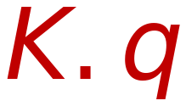
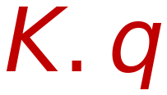
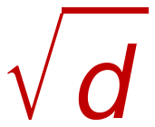


Self Attention Mechanism (Adding Scaling)
38
(Self Attention of word X₂ w.r.t All words in Sentence ( X₁, X₂, X₃, X₄ )
Y₂
MatMul
Similarity
Probabilities
Weighted SUM
SoftMax
Dot
Product
Soft max
Σ
Mask (opt.)
W_{k}⁽¹⁾
K₄
V₄
W_{v}⁽¹⁾
Scale
X₄
X₄
MatMul
X₃
W_{k}⁽¹⁾
K₃
V₃
W_{v}⁽¹⁾
X₃
Scaling by √d
Q
K
V
X₂
W_{k}⁽¹⁾
K₂
V₂
W_{v}⁽¹⁾
X₂
X₁
W_{k}⁽¹⁾
K₁
V₁
W_{v}⁽¹⁾
X₁
q₂
W_{q}⁽¹⁾
W
=
X₁
X₂
X₃
X₄
d: Embedding Length

