Slide 1
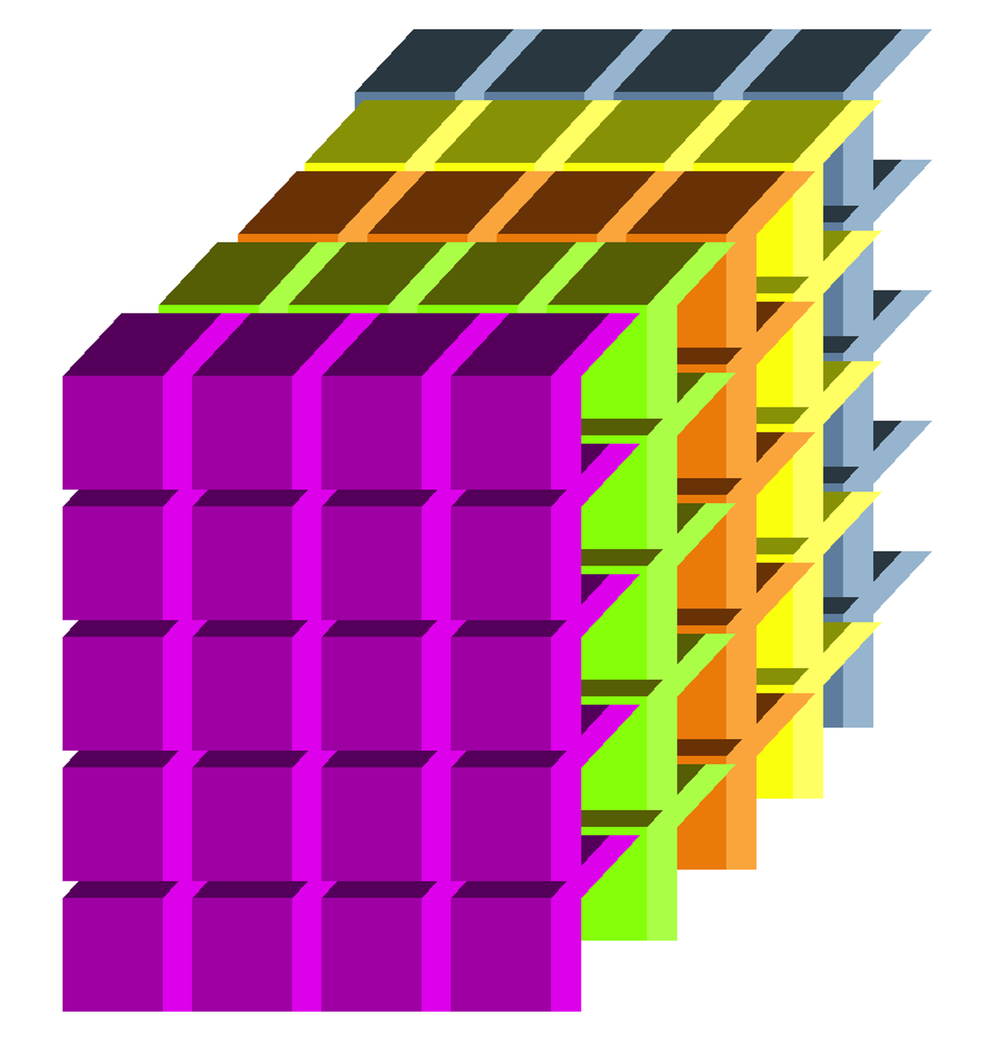


42
Batch Data (Feature Vectors)
Feature Vectors of :
FIVE Input Samples [mini-Batch]
Using 4 filters [ 4 Channels]
Feature Vector of One Input
Sample (Using one filter)
Feature Vectors of One Input Sample
(Using 4 filters) [ 4 Channels]
Feature Vector
Batch size
(5 samples)
Channels
(4 Filters)

