Slide 1
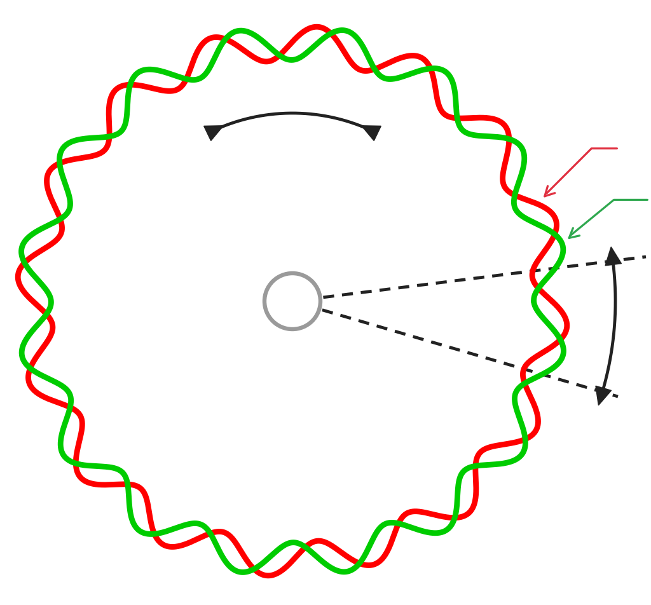
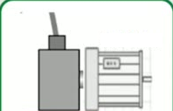
25
Sine/Cosine Encoders
(an industrial application of Motor Control System)
AC Motor
Rotation direction
cos
CCW/CW
sin
Sin/Cos Encoder
Output Signals
Sin/Cos signal period
Sin/Cos
Encoder
Line count =16
(16 signal periods per
revolution)
Incremental rotary position encoders are used in many applications to
measure angular position and speed.
For More Info:
EXTRACTION OF HIGH RESOLUTION POSITION INFORMATION FROM SINUSOIDAL ENCODERS
J. Burke, J. F. Moynhan, K. Unterkofler

