Slide 1















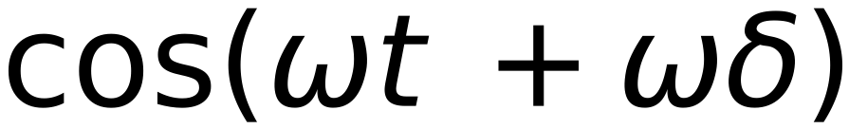





30
$$sin(ωt)$$
Vector of Pos “t”
$$cos(ωt)$$
Remember:
$$Sin (ω$$
$$(t+δ))$$
$$sin(a+b)=sin (a) cos(b) + cos(a) sin(b)$$
$$cos(a+b)=cos(a) cos(b)-sin(a) sin(b)$$
Vector of Pos “t+δ”
$$cos(ω$$
$$(t+δ))$$
$$sin(ω$$
$$(t+δ))$$
$$=$$
$$sin(ωt +ωδ)$$
$$=$$
$$sin(ωt)$$
$$cos(ωδ)$$
$$+$$
$$cos(ωt)$$
$$sin(ωδ)$$
$$cos(ω$$
$$(t+δ))$$
$$=$$
$$cos(ωt +ωδ)$$
$$=$$
$$cos(ωt)$$
$$cos(ωδ)$$
$$sin(ωt)$$
$$sin(ωδ)$$
$$Sin (ω$$
$$(t+δ))$$
$$cos(ωδ)$$
$$sin(ωδ)$$
$$sin(ωt)$$
From Computer Graphics:
$$cos(ω$$
$$=$$
Rotation Matrix of Vector at
$$(t+δ))$$
$$sin(ωδ)$$
$$cos(ωδ)$$
Pos “t” with angle “ωδ”
$$cos(ωt)$$
Vector of Pos “t+δ”
e.g “ω” , “2ω” , “3ω” , ...
Vector of Pos “t”
Independent of Position “t”

