Slide 1
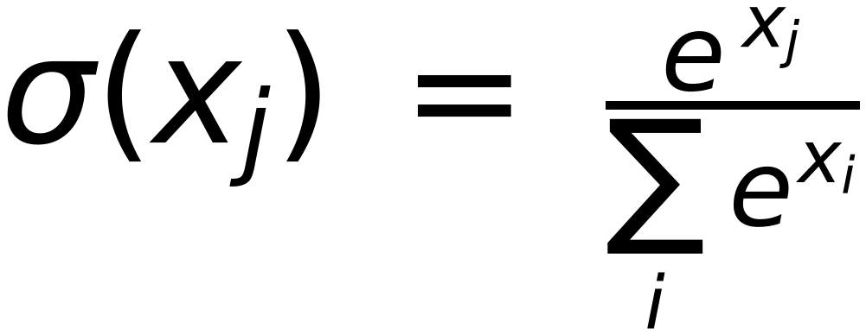
Self Attention Look Ahead Mask
53
(Used in Decoder first Block )
Softmax
$$σ(x_{j})=\frac{e^{x_{j}}}{\sum_{i}{e^{x_{i}}}}$$
SOS
Je
me
sens
malade
SOS
0
−∞
−∞
−∞
−∞
Je
0
0
−∞
−∞
−∞
me
0
0
0
−∞
−∞
sens
0
0
0
0
−∞
malade
0
0
0
0
0
Mask Values are ADDED to Masked (Scaled) Values
Addition of “0” does not change the original values, consequently no effect on Softmax output
Addition of “-inf” gets “Zero” output of Softmax, leaving zero attention scores for future Words.

