Slide 1




































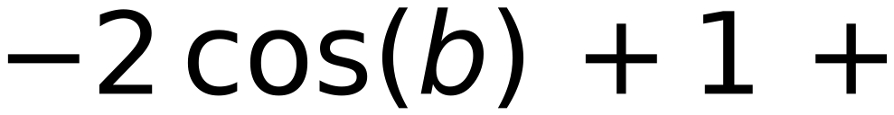



Vector at Pos “t”
Vector at Pos “t+δ”
31
$$sin(ωt)$$
$$Sin (ω(t+δ))$$
$$sin(ωt)$$
$$cos(ωδ)$$
$$+$$
$$cos(ωt)$$
$$sin(ωδ)$$
$$cos(ωt)$$
$$cos (ω(t+δ))$$
$$=$$
$$cos(ωt)$$
$$cos(ωδ)$$
$$-$$
$$sin(ωt)$$
$$sin(ωδ)$$
$$Let$$
$$ωt=a ,$$
$$ωδ=b$$
$$sin(a)$$
$$sin(a)$$
$$cos(b)$$
$$+$$
$$cos(a)$$
$$sin(b)$$
$$cos(a)$$
$$\sin^{2}(a)+\cos^{2}(a)=1$$
$$cos(a)$$
$$cos(b)$$
$$-$$
$$sin(a)$$
$$sin(b)$$
Squared Distance Between
Vector of Pos “t+δ”
and
Vector of Pos “t”
[ Two Consecutive Positions ]
$$[$$
$$sin(a)$$
$$cos(b) +$$
$$cos(a)$$
$$sin(b) -$$
$$sin(a)$$
$$]^{2} + [ -$$
$$sin(a)$$
$$sin(b) +$$
$$cos(a)$$
$$cos(b) -$$
$$cos(a)$$
$$]^{2}$$
$$=$$
$$[ sin(a) (cos(b)-1)+cos(a) sin(b) ]^{2}+ [ -sin(a) sin(b)+cos(a) (cos(b)-1) ]^{2}$$
$$=$$
$$[ sin(a)^{2}(cos(b)-1)^{2}+\cos^{2}(a) \sin^{2}(b)+ 2 sin(a) cos(a) sin(b) (cos(b)-1) ] +$$
$$[ \sin^{2}(a) \sin^{2}(b)+\cos^{2}(a) (cos(b)-1)^{2}- 2 sin(a) cos(a) sin(b) (cos(b)-1) ]$$
$$=$$
$$sin(a)^{2} (cos(b)-1)^{2}+\cos^{2}(a) \sin^{2}(b)+\sin^{2}(a) \sin^{2}(b)+\cos^{2}(a) (cos(b)-1)^{2}$$
$$=$$
$$[ sin(a)^{2}+\cos^{2}(a) ] (cos(b)-1)^{2}+ [ sin(a)^{2}+\cos^{2}(a) ] (\sin^{2}(b) )=(cos(b)-1)^{2}+\sin^{2}(b)$$
$$=$$
Irrespective of Position “t”
$$\cos^{2}(b)$$
$$-2 cos(b) +1 +$$
$$\sin^{2}(b)$$
$$= 2 -2 cos(b) = 2(1-cos(b) )$$
$$=2 (1-cos(ωδ))$$

