Slide 1
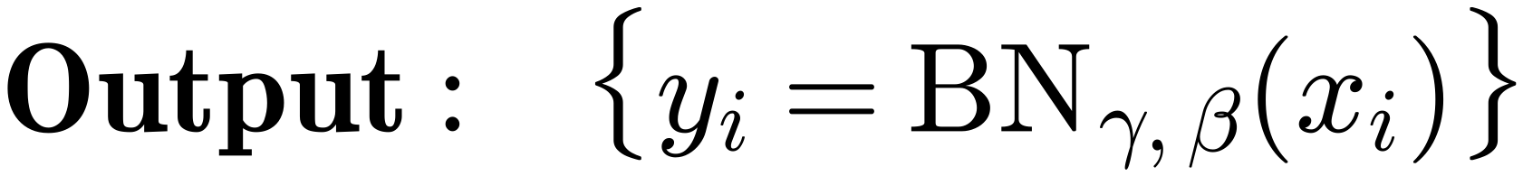
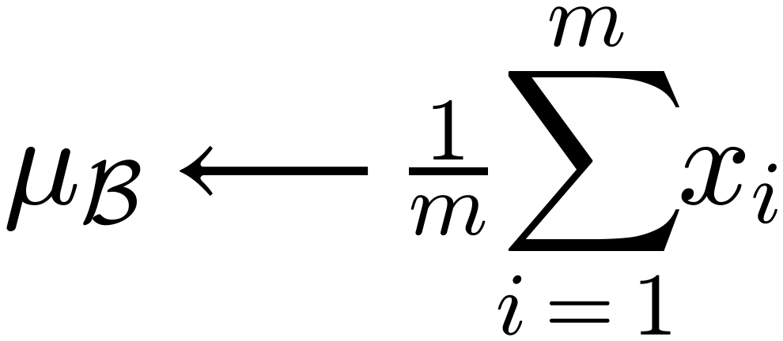
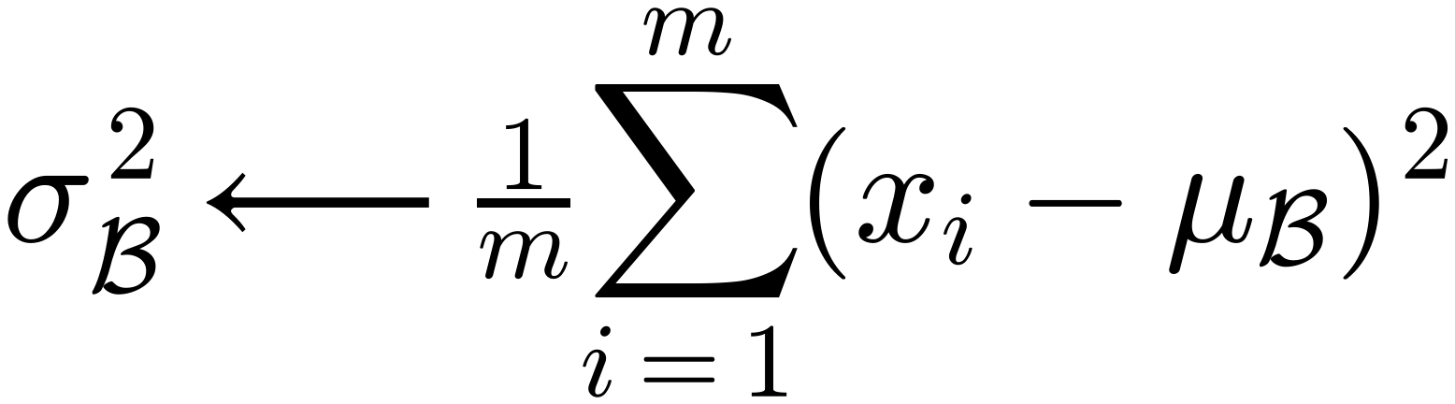
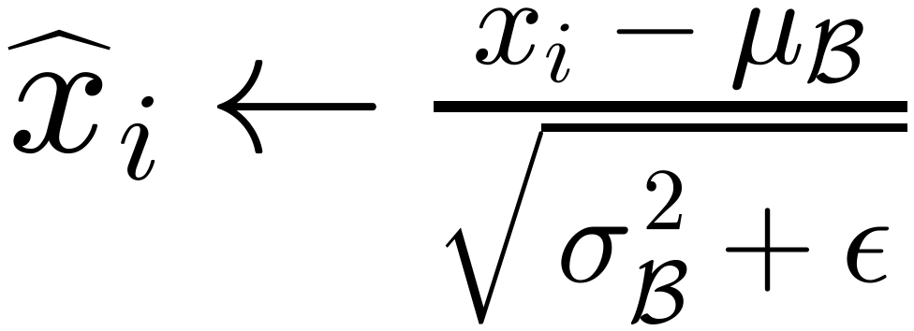
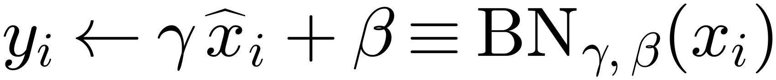
Normalization Parameters
40
Instead of restricting the Activations of each layer to be strictly Zero mean and unit variance,
Normalization allows the network to
learn parameters γ and β that can convert the mean and
variance to any value that Minimizes Loss.
$$Input: Values of x over a mini-batch: ℬ=\{x_{1…m}\};$$
$$Parameters to be learned: γ, β$$
$$Output: \{y_{i}={BN}_{γ,β}(x_{i})\}$$
$$μ_{ℬ}⟵\frac{1}{m}\sum_{i=1}^{m}{x_{i}}$$
// mini-batch mean
$$σ_{ℬ}^{2}⟵\frac{1}{m}\sum_{i=1}^{m}{(x_{i}-μ_{ℬ})^{2}}$$
// mini-batch variance
$${\hat{x}}_{i}←\frac{x_{i}-μ_{ℬ}}{\sqrt{σ_{ℬ}^{2}+ε}}$$
// normalize
$$y_{i}←γ {\hat{x}}_{i}+β≡{BN}_{γ,β}(x_{i})$$
// scale and shift

