Slide 1
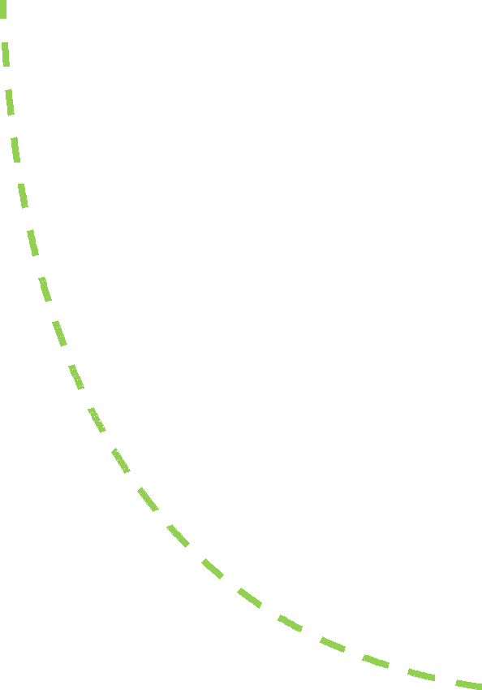
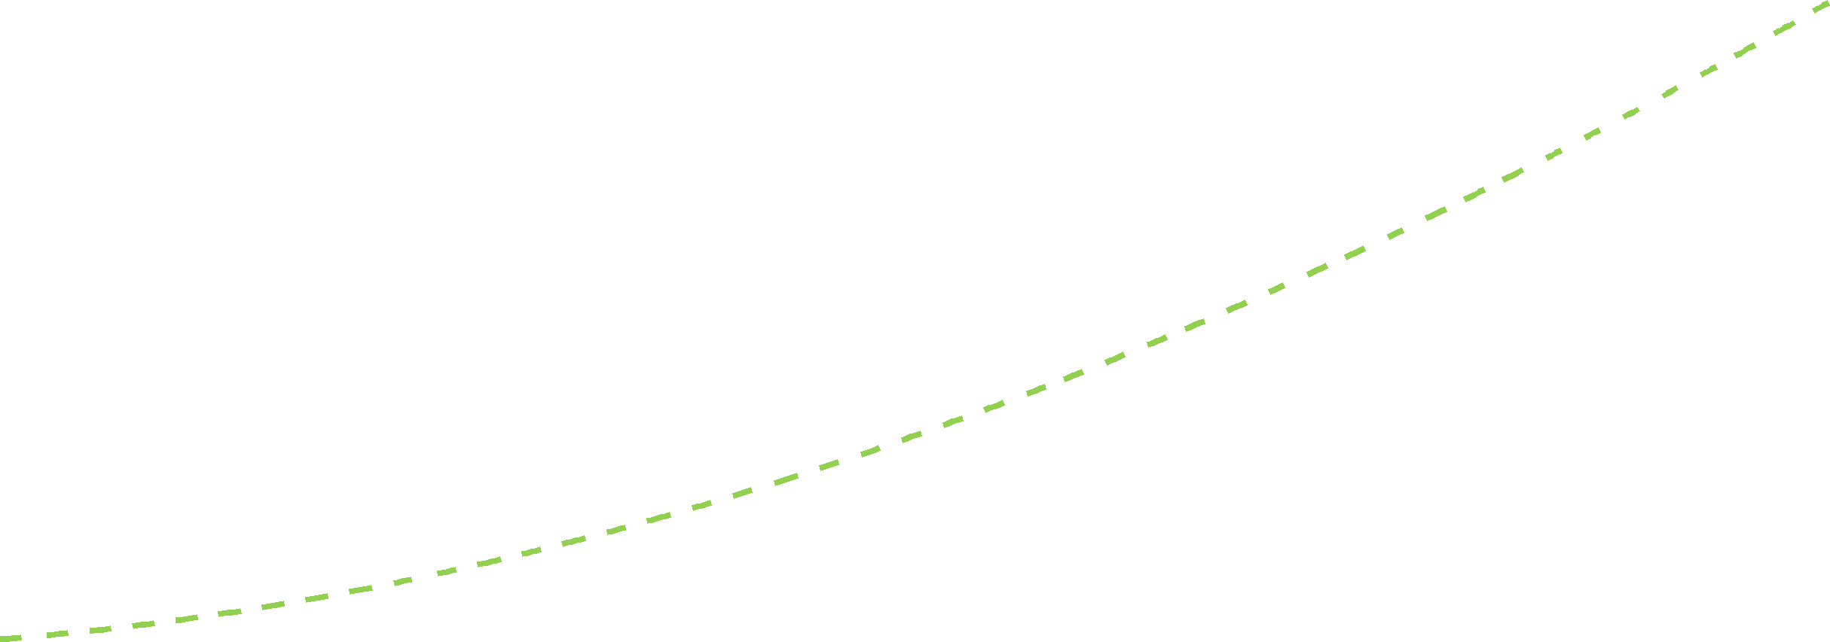
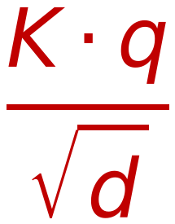
Self Attention Mechanism for Decoder (Adding Mask)
54
-−∞
*
Z
Similarity
Probabilities
Weighted SUM
Dot
Product
K·q
$$\frac{K⋅q}{\sqrt{d}}$$
Σ
Mask
Z₄
W_{k}^{(r)}
K₄
-−∞
0
×
V₄
W_{v}^{(r)}
Z₄
W_{k}^{(r)}
Soft max
W_{v}^{(r)}
Z₃
K₃
-−∞
×
V₃
Z₃
Scaling by √d
ς
Z₂
W_{k}^{(r)}
K₂
0
×
V₂
W_{v}^{(r)}
Z₂
Z₁
W_{k}^{(r)}
K₁
0
×
V₁
W_{v}^{(r)}
Z₁
q₂
Look Ahead
Mask
W_{q}^{(r)}
1×d
W
=
Z₁
Z₂
Z₃
Z₄
d×d
1×d
d: Embedding Length

