Slide 1
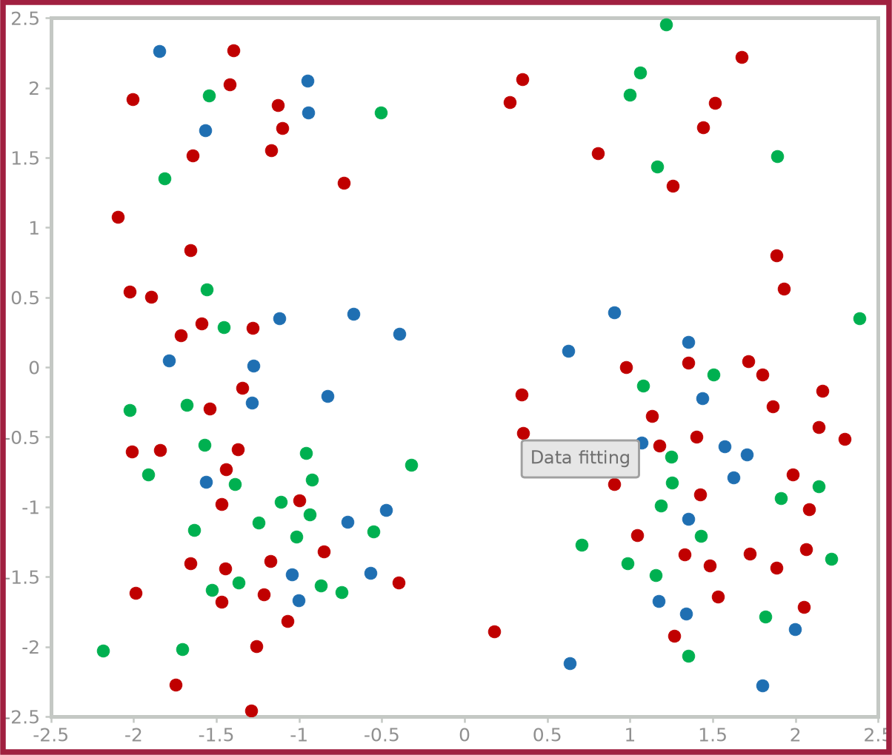
Linearly separable vs. Not linearly separable
35
Linearly separable
Not linearly separable
A linear decision boundary that separates the two classes exists
No linear decision boundary that separates the two classes perfectly exists
x2
x2
Nonlinear boundary
x2
Linear boundary
x1
x1
x1

