Slide 1
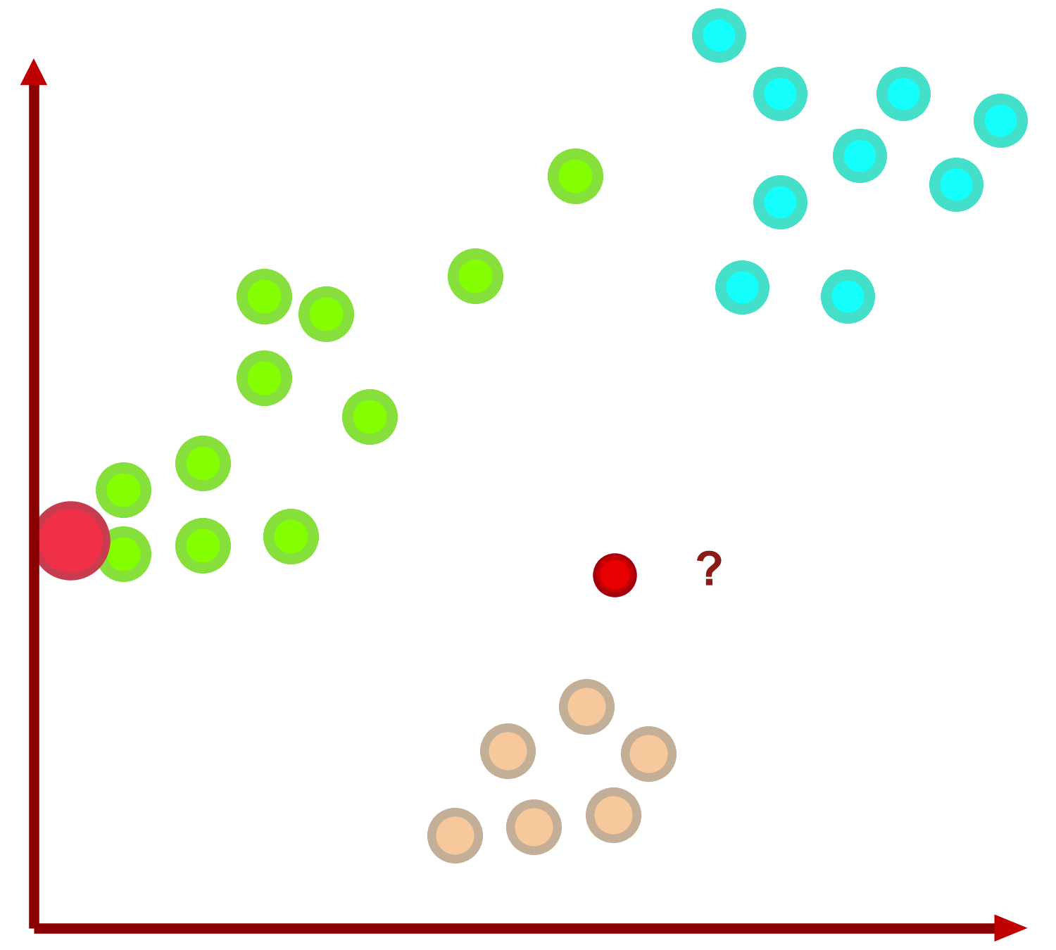
Nearest Neighbors (NN) Example
43
Data of Three Classes and ONE TEST sample

