Slide 1
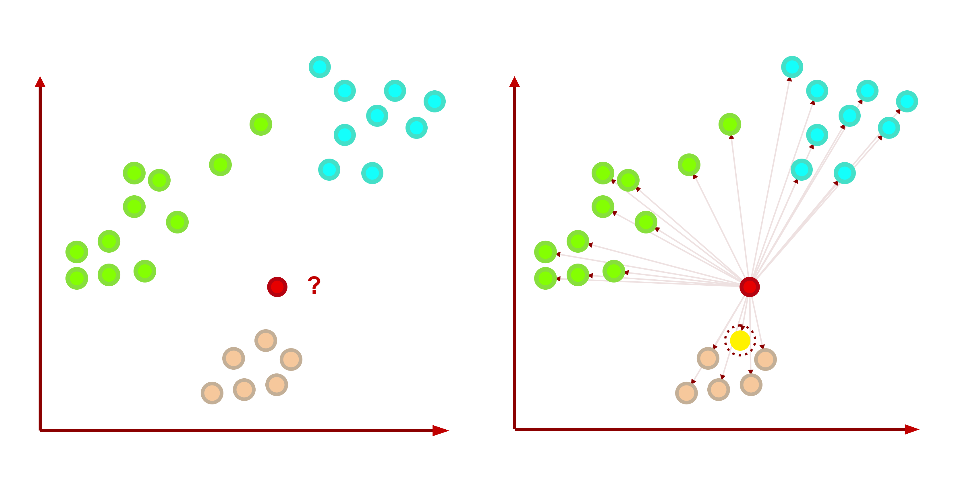
Nearest Neighbors (NN) Example
44
Data of Three Classes
Nearest Neighbor is the Orange class

