Slide 1
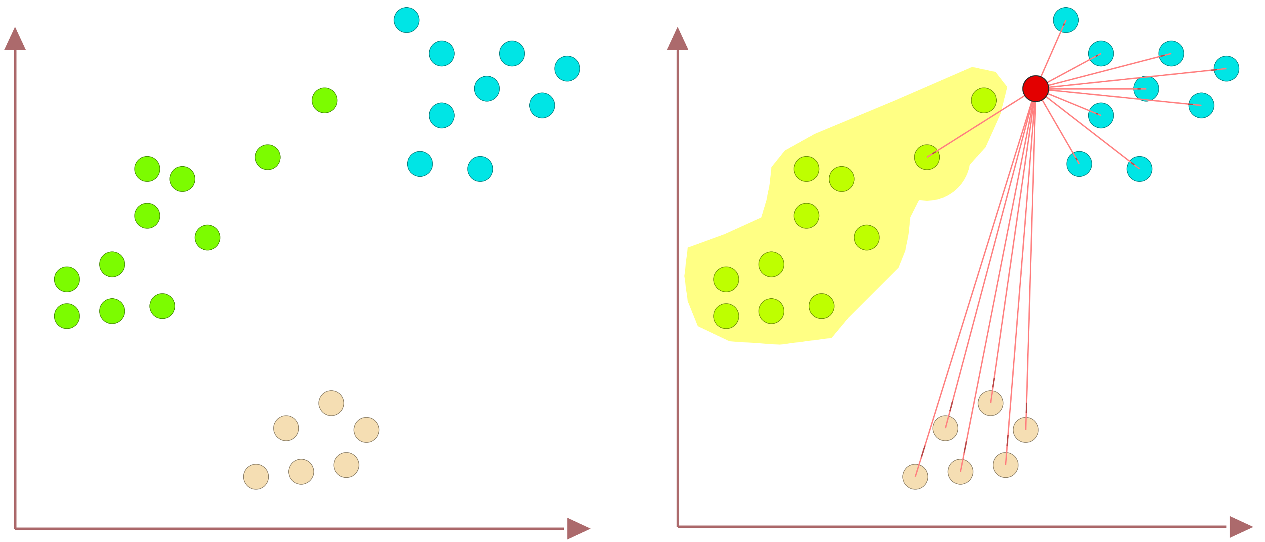
Nearest Neighbors (NN) Outlier Problem
46
Outlier
Sample
Data of Three Classes
Nearest Neighbor is the Green class

