Slide 1
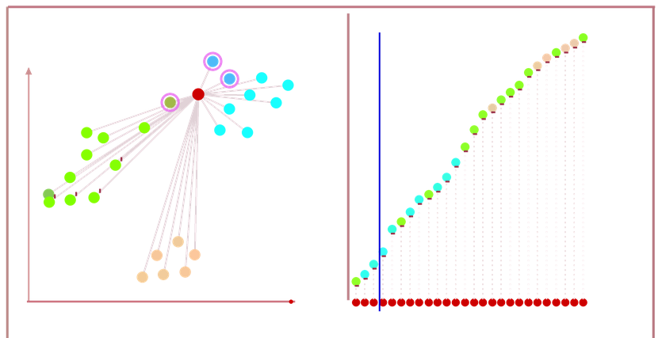
K-Nearest Neighbors (KNN) , K=3
48
K=3, cyan class
Select Nearest 3 Neighbors
Vote on 3 Nearest Neighbors

