Slide 1
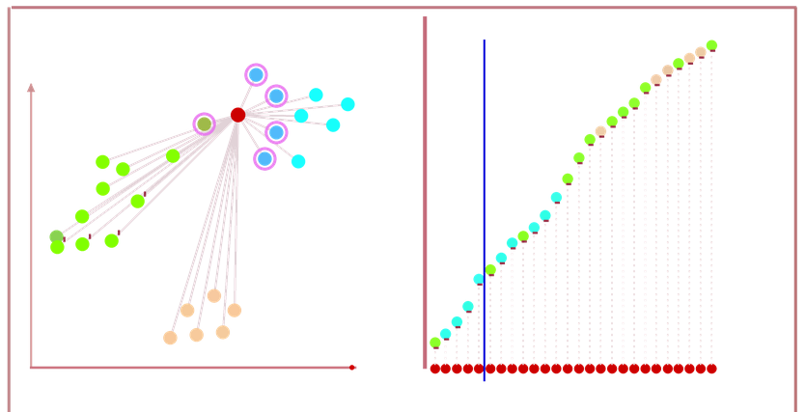
K-Nearest Neighbors (KNN) , K=5
49
K=5, cyan class
Select Nearest 5 Neighbors
Vote on 5 Nearest Neighbors

