Slide 1




















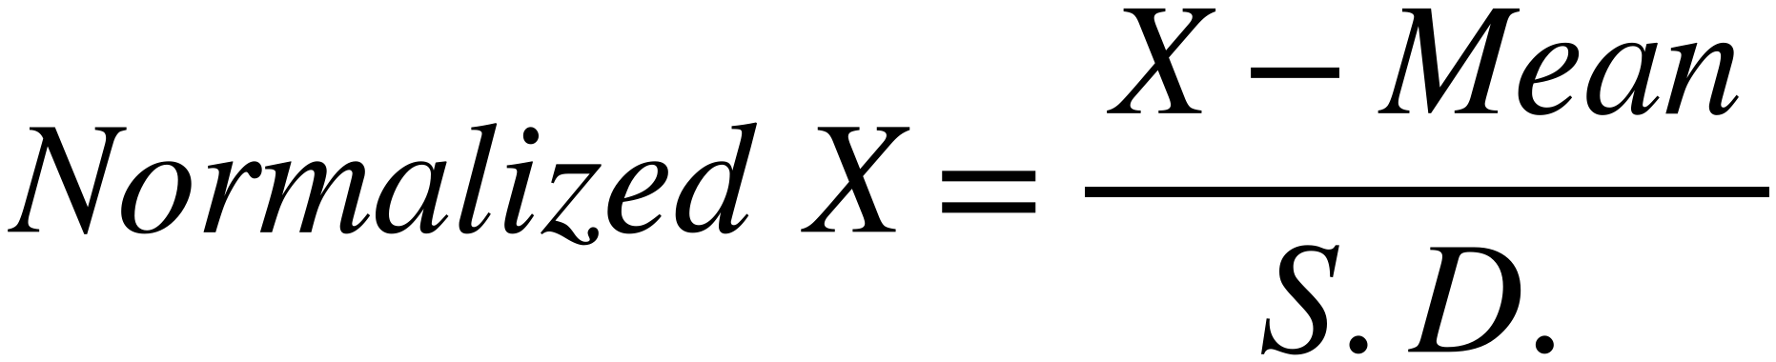
Example: Distance with Normalization
54
Feature Vector for bars:
Red Class
Blue Class
Green Class
Mean
S.D
2
+
Weight (KG)
3
4
7
8
9
12
13
14
8
4.163
Length (cm)
100
150
200
150
200
250
150
250
300
194.44
59.835
Normalized Red Class
Normalized Blue Class
Normalized Green Class
Normalized Test
Weight (KG)
−1.441
−1.201
−0.961
−0.24
0
0.24
0.961
1.201
1.441
−0.24
Length (cm)
−1.578
−0.743
0.093
−0.743
0.093
0.928
−0.743
0.928
1.764
−1.244
Squared distance between each Normalized vector and Normalized test vector
(
1.554
1.175
)
(
)
(
)
2.307
0.251
1.845
4.948
1.693
6.794
11.874
$$Normalized X=\frac{ X-Mean }{S.D.}$$
7
100
Belongs to
Blue Class

